Slide 1
Concepts of
Computing
Technologies
Directory and Access Management:
Active Directory DNS
Part 1: What is DNS and its hierarchical naming structure
Notes:
Advanced Learning Assistant Seminar, Spring 2018, Patrick Richeal, richealp7@students.rowan.edu

Slide 2
Objectives
By the end of this lesson, you should be able to:
Understand what DNS is and how it relates to Active Directory
Understand the hierarchical structure of DNS
Notes:
By the end of this lesson, you should be able to understand what DNS is and how it relates to Active Directory and understand the hierarchical structure of DNS.

Slide 3
Active Directory DNS
Domain Name System (DNS) is the primary TCP/IP name resolution service for AD DS
DNS helps locate resources via the internet
There are organizations that sell DNS as a service (Azure DNS, Amazon Route 53, etc.), but organizations can also host their own DNS servers
Notes:
Domain Name System, or DNS, is the primary TCP/IP name resolution service for Active Directory Domain Services. DNS helps locate resources via the internet. There are organizations that sell DNS as a service (Azure DNS, Amazon Route 53, etc.), but organizations can also host their own DNS servers.

Slide 4
What is DNS?
DNS maps one thing that is difficult to remember to something that is easier to remember
In our phones, there are contact books that map names to phone numbers
This exists so we don’t have to remember every person’s phone number, we can just interact and use their name to call them or send text messages
This is similar to what DNS does, except DNS maps IP addresses to domain names
Notes:
DNS maps one thing that is difficult to remember to something that is easier to remember. In our phones, there are contact books that map names to phone numbers. This exists so we don’t have to remember every person’s phone number, we can just interact and use their name to call them or send text messages. This is similar to what DNS does, except DNS maps IP addresses to domain names.

Slide 5
Why does AD need DNS?
There would be no functioning AD domain infrastructure without DNS
There are two main reasons for this
  DNS maintains hierarchical infrastructure design
    Domain namespaces are used to separate multiple forests, domains, and child domains from each other and build the AD hierarchy
    The only way to logically represent that infrastructure hierarchy is with DNS
  DNS is used to locate domain controllers
    Devices in infrastructures need to communicate with AD domain controllers for authentication
    If it’s a remote site, the device would need to locate the closest domain controller for authentication which is done using DNS service (SRV) records
    DNS also helps resolve the location of a host or other resources
Notes:
So why does Active Directory need DNS? There would be no functioning Active Directory domain infrastructure without DNS. There are two main reasons for this. The first is that DNS maintains hierarchical infrastructure design. Domain namespaces are used to separate multiple forests, domains, and child domains from each other and build the Active Directory hierarchy. The only way to logically represent that infrastructure hierarchy is with DNS. The second reason is that DNS is used to locate domain controllers. Devices in infrastructures need to communicate with Active Directory domain controllers for authentication. If it’s a remote site, the device would need to locate the closest domain controller for authentication which is done using DNS service records. DNS also helps resolve the location of a host or other resources.

Slide 6
DNS Database
DNS maintains a database that contains various DNS types like (A, MX, SRV, AAAA) which can be distributed among multiple servers
This database provides control over the DNS infrastructure and enables administrators to add/edit/delete DNS entries
A read only copy of this database can also be shared, where the infrastructure security is not guaranteed
Notes:
DNS maintains a database that contains various DNS types like (A, MX, SRV, AAAA) which can be distributed among multiple servers. This database provides control over the DNS infrastructure and enables administrators to add/edit/delete DNS entries. A read only copy of this database can also be shared, where the infrastructure security is not guaranteed.

Slide 7
Hierarchical Structure
We already know how domain trees can be used to organize the domain structure in the hierarchical method
DNS allows you to translate that hierarchical structure into the domain namespace
Similar to a tree, it starts with a root and is spread into different layers of branches and leaves
In the domain tree, the root is represented by a dot (.)
A branch, which can contain many leaves, represents a collection of named resources
A leaf in a domain tree represents a single named entry
Notes:
We already know how domain trees can be used to organize the domain structure in the hierarchical method. DNS allows you to translate that hierarchical structure into the domain namespace. Similar to a tree, it starts with a root and is spread into different layers of branches and leaves. In the domain tree, the root is represented by a dot. A branch, which can contain many leave, represents a collection of named resources. A leaf in a domain tree represents a single named entry.

Slide 8
Leaf-Branch Dependency
In a tree, branches and leaves depend on each other
When we describe a leaf or a branch, we always describe it in the context of a tree
For example, if you need to show someone the leaf of an apple tree, you would call it an apple leaf
  You explain the leaf in the context of the tree so the person knows all the information about the leaf
We need to represent a domain leaf in the same way, in the context of the branches it comes from leading to the root
When the path of a domain tree is put together to create a domain name, each level is separated by a dot, beginning with the leaf and moving to the root
Notes:
In a tree, branches and leaves depend on each other. When we describe a leaf or a branch, we always describe it in the context of a tree. For example, if you need to show someone the leaf of an apple tree, you would call it an apple tree leaf. You explain the leaf in the context of the tree so the person knows all the information about the leaf. We need to represent a domain leaf in the same way, in the context of the branches it comes from leading to the root. When the path of a domain tree is put together to create a domain name, each level is separated by a dot, beginning with the leaf and moving to the root.

Slide 9
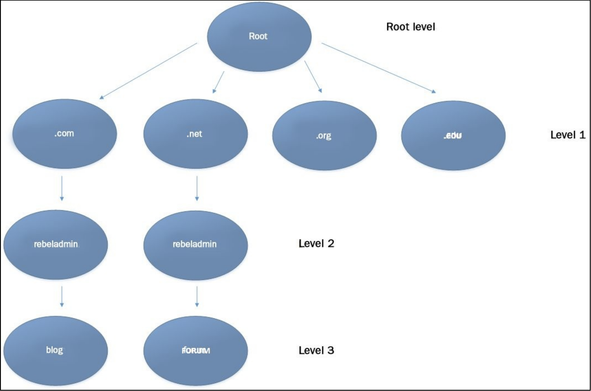
Domain Tree Example
Source: Mastering Active Directory, Dishan Francis
Notes:
Here is an example of a possible domain tree. We can see the first path creates the domain name blog.rebeladmin.com, and that the second path creates the domain name forum.rebeladmin.net.

Slide 10
Level 1, Top Level Domains (TLD)
Level 1 of the diagram represents the top level domains which are maintained by the internet name registration authority according to international standards
Source: Mastering Active Directory, Dishan Francis
Notes:
Level 1 of the diagram represents the top level domains which are maintained by the internet name registration authority according to international standards. In this diagram, this includes .com, .net, .org, and .edu.

Slide 11
Common Top Level Domains
The following are some common top level domains
  .com – Most commonly used, usually for businesses that focus on profit, personal websites, blogs, community websites, etc. (open for anyone to register)
  .org – Mainly used by non profit organizations (open for anyone to register)
  .net – Used to represent distributed computer networks (open for anyone to register)
  .edu – Limited to educational institutes (not open for anyone to register)
  .gov – Limited to government entities (not open for anyone to register)
Notes:
There are a few very common top level domains. .com is the most commonly used, and is usually used for businesses that focus on profit, personal websites, blogs, or community websites. It is open for anyone to register. .org is mainly used by non profit organizations and is also open for anyone to register. .net is used to represent distributed computer networks and is also open for anyone to register. .edu is limited to educational institutes and is not open for anyone to register. Similarly, .gov is limited to government entities and is also not open for anyone to register.

Slide 12
Level 2, The Domain
Level 2 in the hierarchy is controlled by the organization itself
This is where the root domain name lives
Source: Mastering Active Directory, Dishan Francis
Notes:
Level 2 in the hierarchy is controlled by the organization itself. This is where the root domain name lives. In this domain tree, we can see two root domains of rebeladmin.com and rebeladmin.net.

Slide 13
Domain Name Registration
Domain names can be purchased from domain name registrars
Once a domain name is registered, no one else can create one with the same name under the same top level domain
Depending on the use of the domain, some DNS records might need to be public on the internet
  If you want to host a website under your domain that will be publicly accessible on the internet, a public DNS record needs to be available that maps your server’s IP address to the domain name
  The organization that registers your domain for you usually includes a DNS server to contain those public records
Notes:
Domain names can be purchased from domain name registrars. Once a domain name is registered, no one else can create one with the same name under the same top level domain. Depending on the use of the domain, some DNS records might need to be public on the internet. If you want to host a website under your domain that will be publicly accessible on the internet, a public DNS record needs to be available that maps your server’s IP address to the domain name. The organization that registers your domain for you usually includes a DNS server to contain those public records.

Slide 14
Level 3, The Subdomain
Level 3 in the hierarchy is again controlled by the organization itself
The domain name owner has complete control to create as many subdomains under the domain name as they wish
mail.google.com is an example of a subdomain under a domain name
Source: Mastering Active Directory, Dishan Francis
Notes:
Level 3 in the hierarchy is again controlled by the organization itself. The domain name owner has complete control to create as many subdomains under the domain name as they wish. mail.google.com is an example of a subdomain under a domain name. In this domain tree, we can see each root domain name has one sub domain. This gives us two full domain paths of blog.rebeladmin.com and forum.rebeladmin.net.

Slide 15
References
EMC Education Services. 2012. Information storage and management: storing, managing, and protecting digital information 2nd ed., Hoboken, NJ: Wiley.
D. Francis, Mastering Active Directory. Birmingham: Packt, 2017.

