Slide 1
Concepts of Computing Technologies Directory and Access Management: Designing Active Directory Infrastructure
Notes:
201820-CS99310 - ADV LEARN ASST SEMINAR COM SCI (Section 1)
John Pansera
panseraj3@students.rowan.edu

Slide 2
Objectives
By the end of this lesson, you should be able to:
Know the two types of domain models
Know the amount of bandwidth required for an amount of users in a domain controller
Know how to choose domain names (AD Domains/DNS)

Slide 3
Domain Models
There are two types of domain models:
Single Domain Model
Regional Domain Model

Slide 4
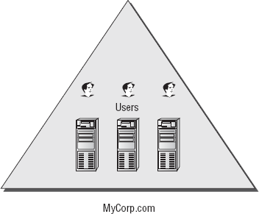
Single Domain Model
The single domain model includes one forest (the root forest domain), which contains:
User Accounts
Group Accounts
Easier to administer/manage
Costs less to maintain
Creates more replication traffic
Directory data needs to be replicated to other available domain controllers.

Slide 5
Regional Domain Model
Uses multiple domains (subdomains).
Object data within the domain is replicated to all domain controllers.
Regional domains can be geographically categorized.
Allows a more stable environment to be maintained over time.
Reduces replication traffic over the WAN (Wide Area Network).
Consists of:
A forest root domain
One or more regional domains

Slide 6
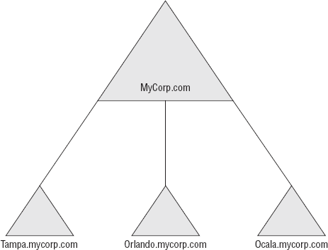
Regional Domain Model Example
In this example, there are three domains nested under the root domain (MyCorp.com), and they are based on the locations of the company.

Slide 7
The Number of Domains
Each forest starts with one domain.
The amount of users that a domain forest can contain depends on the available bandwidth which can be used for replication.

Slide 8
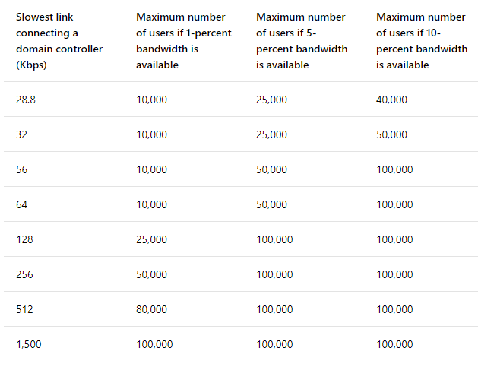
Domain Bandwidth Table
The table above shows estimated bandwidth requirements for different amounts of users on a domain controller. This is based on the bandwidth that would be taken up by replication.

Slide 9
Domain Names
Domains in forests need to have unique names.
There are two types of domain names.
Active Directory Domains
DNS Names
An example would be the following:
AD Domain: CORP
DNS Name: intranet.example.org
AD Domain Names are also referred to as NetBIOS names, and can be used in the AD logon name: <DOMAIN>\<UserName>.
Example: CORP\Administrator
The DNS name contains the subdomain, domain, and TLD - while the AD Domain is the NetBIOS name of CORP.

Slide 10
Deciding Domain Names
Things to keep in mind when deciding a domain name:
Use one that you own through a registrar
Be careful with spelling
Do not use numbers or special characters

Slide 11
Forest Root Domain
The root domain is the first domain setup in the forest.
It contains the following groups:
Enterprise Admins
Schema Admins
In the multiple domain model, there are two types:
Dedicated Forest Root Domain
Regional Forest Root Domain
Notes:
https://docs.microsoft.com/en-us/windows-server/identity/ad-ds/plan/selecting-the-forest-root-domain

Slide 12
Dedicated Forest Root Domain
A separate domain which is dedicated to being the forest root.
It should not have a geographical naming convention.
Does not contain:
Regular User Accounts
Objects
Resources
Example:
Rebeladmin.com

Slide 13
Regional Forest Root Domain
The regional domain can also be the forest root domain.
It becomes the parent domain for other regional domain controllers.
Example:
HQ.rebeladmin.com

Slide 14
Deciding Domain and Forest Function Levels
The next step is to decide the domain and forest functional levels.
These define the AD DS features which can be used in the identity infrastructure.
Once these levels are defined, older domain controllers will not be able to be added to the forest.
Things to consider:
Existing Domain Controllers – If you have existing domain controllers and new ones are added to them, the domain controller with the oldest operating system defines the maximum forest/domain functional level.
Application Requirements – Some applications may require a certain domain/forest functional levels. It is best to check application compatibility before deciding.

Slide 15
References
EMC Education Services. 2012. Information storage and management: storing, managing, and protecting digital information 2nd ed., Hoboken, NJ: Wiley.
Francis, Dishan. Mastering Active Directory: Automate Tasks by Leveraging PowerShell for Active Directory Domain Services 2016. Packt Pub., 2017.
Billmath. “Reviewing the Domain Models.” Microsoft Docs, Microsoft, 31 May 2017, https://docs.microsoft.com/en-us/windows-server/identity/ad-ds/plan/reviewing-the-domain-models.
“Active Directory: Best Practices for Internal Domain and Network Names.” TechNet Articles - United States (English) - TechNet Wiki, Microsoft, https://social.technet.microsoft.com/wiki/contents/articles/34981.active-directory-best-practices-for-internal-domain-and-network-names.aspx.

