Slide 1
Concepts of Computing Technologies Directory and Access Management: Designing Active Directory Infrastructure
Notes:
201820-CS99310 - ADV LEARN ASST SEMINAR COM SCI (Section 1)
John Pansera
panseraj3@students.rowan.edu

Slide 2
Objectives
By the end of this lesson, you should be able to:
Plan the structure of an Active Directory infrastructure
Know the two types of forest models
Know about two aspects of forest structures

Slide 3
Planning
Before designing the Active Directory infrastructure, you will need to plan out what your business requires from the service.

Slide 4
Designing the Forest Structure
Forest: A complete instance of Active Directory.
Every Active Directory infrastructure has at least one forest.
Types of Forest Models
Single Forest
Multiple Forest

Slide 5
Single Forest Model
This is the default forest model
Most business models fit into this category
Less complex than the multiple forest model, which means as a result it costs less

Slide 6
Multiple Forest Model
Compared to the single forest model, this model is:
More complex
More costly
Single there are multiple forests, more hardware/software is needed
Use cases:
Businesses with independent groups
Companies which want to share resources

Slide 7
Creating a Forest Design
The next step is to create a forest design.
Need to figure out what requirements groups in your organization need.
Some of these may include:
Organizational Structure Requirements
Operational Requirements
Legal Requirements

Slide 8
Organizational Forest Model
In this forest model, the following are contained in the forest:
User Accounts
Resources
Provides:
Service Autonomy
Service Isolation
Data Isolation
Resources can be shared between forests by using trust relationships.
At least one organizational forest is present in every Active Directory design.

Slide 9
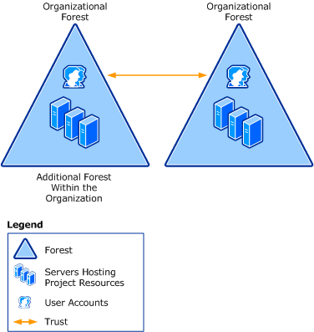
Organizational Forest Model Diagram

Slide 10
Resource Forest Model
In this forest model, resources are managed separately in a different forest.
This is known as a Resource Forest.
Provides:
Service Isolation
A Resource Forest does not contain user accounts.
Other users from different forests can access data using forest trusts.
Notes:
This forest model can be used in parts of businesses which need to maintain availability to the system.

Slide 11
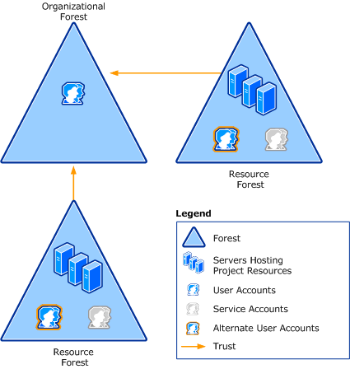
Resource Forest Model Diagram

Slide 12
Restricted Access Forest Model
In this forest model, users or data which need to be isolated are put in a separate forest.
Provides:
Data Isolation
Requirements:
A different user account will be needed to access the restricted forest.
A separate physical computer will be needed by the user to access it.
Depending on the importance of the data on the restricted forest, it can be put on a completely different network.

Slide 13
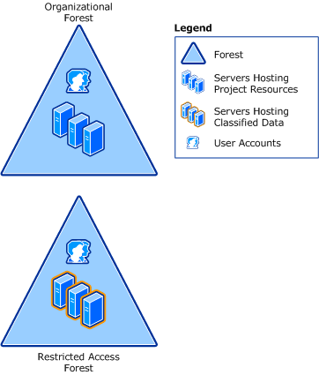
Restricted Access Forest Model Diagram
Notes:
The Restricted Access Forest in this diagram shows the separate forest which is being used for resources.

Slide 14
Trust Relationships
Trust Relationships allow you to provide security across multiple domains.
There are several types of Trust Relationships:
Parent/Child Trust
Tree Root Trust
Shortcut Trust
External Trust
Realm Trust
Forest Trust

Slide 15
References
EMC Education Services. 2012. Information storage and management: storing, managing, and protecting digital information 2nd ed., Hoboken, NJ: Wiley.
Francis, Dishan. Mastering Active Directory: Automate Tasks by Leveraging PowerShell for Active Directory Domain Services 2016. Packt Pub., 2017.
Billmath. “Forest Design Models.” Microsoft Docs, Microsoft, 31 May 2017, https://docs.microsoft.com/en-us/windows-server/identity/ad-ds/plan/forest-design-models.
“Active Directory Trust Relationships.” Active Directory Trust Relationships, TechieBird, http://www.techiebird.com/wintrust.html.

