Slide 1
Concepts of Computing Technologies Directory and Access Management: Active Directory Domain Services 2016 Security Improvements
Part 3: Time-based group memberships and Privileged Access Management
Notes:
Advanced Learning Assistant Seminar, Spring 2018, Patrick Richeal, richealp7@students.rowan.edu

Slide 2
Objectives
By the end of this lesson, you should be able to:
Understand time-based group memberships
Understand the need for Privileged Access Management (PAM)
Understand the necessary workflow and logistics for PAM to be able to take place
Notes:
By the end of this lesson, you should be able to understand time-based group memberships, understand the need for Privileged Access Management, and understand the necessary workflow and logistics for Privileged Access Management to be able to take place.

Slide 3
Privileged Access Management (PAM)
PAM is not a single feature that can be enabled or disabled, it is a complete workflow of many technologies working together to create a new way of obtaining privileges to be able to do something
The core concept of PAM is time-based group memberships, another new feature of AD DS 2016
Notes:
Privileged Access Management is not a single feature that can be enabled or disabled, it is a complete workflow of many technologies working together to create a new way of obtaining privileges to be able to do something. The core concept of Privileged Access Management is time-based group memberships, another new feature of Active Directory Domain Services 2016.

Slide 4
Time Based Group Memberships
Time-based group memberships are a new feature of AD DS 2016
It allows administrators to assign users to groups for temporary periods of time with a time value
The time value is called a time-to-live (TTL) value, which holds the length of time that the user is assigned to the specific group
Once the time passes the TTL value, the user is automatically removed from the group
Notes:
Time-based group memberships are a new feature of Active Directory Domain Services 2016. It allows administrators to assign users to groups for temporary periods of time with a time value. The time value is called a time-to-live (TTL) value, which holds the length of time that the user is assigned to the specific group. Once the time passes the TTL value, the user is automatically removed from the group.

Slide 5
Example of Time Based Group Membership
Assume a specific admin logs into a specific system once a month to do some maintenance
The admin could have an account that always has those privileges, but than that user’s privileges are vulnerable to be used maliciously for the majority of the month
It would be safer to reduce the period of time the user has those privileges to only when they are needed
This is how time base group memberships can be used for identity security
Notes:
Here is an example usage scenario of a time based group membership. Assume a specific admin logs into a specific system once a month to do some maintenance. The admin could have an account that always has those privileges, but than that user’s privileges are vulnerable to be used maliciously for the majority of the month. It would be safer to reduce the period of time the user has those privileges to only when they are needed. This is how time base group memberships can be used for identity security.

Slide 6
Logic Behind PAM
PAM is based on the just-in-time (JIT) administration concept
In 2014, Microsoft released an update that allowed for just-enough-administration (JEA), which is basically a way to give specific users privileges to do only very specific things, which reduces the privileges of a user that can be used maliciously
The JIT administration concept follows a similar principle but with time
Users will only have the required privileges when it is necessary for what they need to do
Notes:
Privileged Access Management is based on the just-in-time (JIT) administration concept. In 2014, Microsoft released an update that allowed for just-enough-administration (JEA), which is basically a way to give specific users privileges to do only very specific things, which reduces the privileges of a user that can be used maliciously. The just-in-time administration concept follows a similar principle but with time. Users will only have the required privileges when it is necessary for what they need to do.

Slide 7
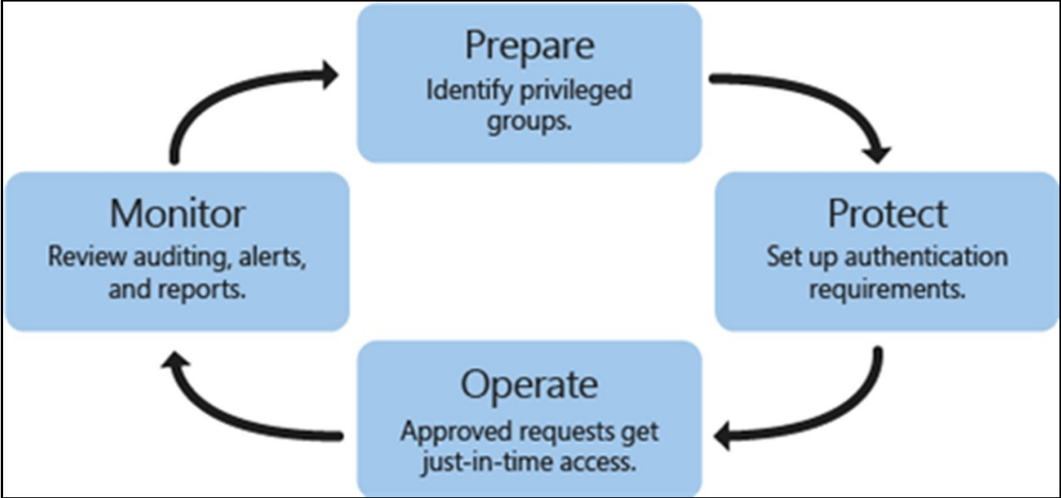
PAM Workflow and Logistics
Setting up PAM in an existing infrastructure can be worked into 4 main categories
Source: https://docs.microsoft.com/en-gb/microsoft-identity-manager/pam/privileged-identity-managementfor-active-directory-domain-services
Notes:
Setting up Privileged Access Management in an existing infrastructure can be worked into four main steps which are to prepare, protect, operate, and monitor.

Slide 8
PAM Workflow: Prepare
The first step is to identify the privileged access groups in the infrastructure and start to remove users from them
The next step would then be to create a bastion forest with equivalent privileged access groups, but assign no users to those groups
Sometimes in an infrastructure, privileges will be assigned to user accounts instead of security groups
If this is the case, then the infrastructure would need to be reworked to have security groups for those users that exist in a bastion forest
Notes:
The first step is to identify the privileged access groups in the infrastructure and start to remove users from them. The next step would then be to create a bastion forest with equivalent privileged access groups, but assign no users to those groups. Sometimes in an infrastructure, privileges will be assigned to user accounts instead of security groups. If this is the case, then the infrastructure would need to be reworked to have security groups for those users that exist in a bastion forest.

Slide 9
Bastion Forest
A bastion forest is a special forest that cannot be used for normal infrastructure operations
Its sole purpose is to contain the security groups that the users get temporarily assigned to and then removed from
The benefit is that at any one point, you can see all users who have the specific privileges of those security groups
Attempting to implement PAM on an existing forest does not achieve this, as permanent users would then be apart of the security groups and you wouldn’t be able to distinguish between temporary, permanent, and potentially malicious accounts
It is important that the security groups in the bastion forest are equivalent (have the same SID) to the security groups that the users were removed from, that way the rest of the infrastructure can trust the bastion forest
Notes:
A bastion forest is a special forest that cannot be used for normal infrastructure operations. Its sole purpose is to contain the security groups that the users get temporarily assigned to and then removed from. The benefit is that at any one point, you can see all users who have the specific privileges of those security groups. Attempting to implement Privileged Access Management on an existing forest does not achieve this, as permanent users would then be apart of the security groups and you wouldn’t be able to distinguish between temporary, permanent, and potentially malicious accounts. It is important that the security groups in the bastion forest are equivalent (have the same SID) to the security groups that the users were removed from, that way the rest of the infrastructure can trust the bastion forest.

Slide 10
PAM Workflow: Protect
The next step is to create a workflow for users to be able to request access for certain privileges
Authentication and authorization needs to be done to ensure the user requesting access is trustworthy
Multi-factor authentication can be used in this process
Setup also needs to be done for the ability for someone to handle requests
Either manual or automatic approval processes can be used to accept or deny incoming privilege requests
Notes:
The next step is to create a workflow for users to be able to request access for certain privileges. Authentication and authorization needs to be done to ensure the user requesting access is trustworthy. Multi-factor authentication can be used in this process. Setup also needs to be done for the ability for someone to handle requests. Either manual or automatic approval processes can be used to accept or deny incoming privilege requests.

Slide 11
PAM Workflow: Operate
Once the privileged access request is approved, the user account will be added to the desired security group in the bastion forest for the specified period in the request, using a time based group membership
The users presence in the bastion forest’s security group is enough for the infrastructure to trust that user and allow them the privileges of that security group for as long as they are apart of the security group
After the time period expires and the user has hopefully completed the action that they were attempting to do, the user is automatically removed from the security group in the bastion forest
Notes:
Once the privileged access request is approved, the user account will be added to the desired security group in the bastion forest for the specified period in the request, using a time based group membership. The users presence in the bastion forest’s security group is enough for the infrastructure to trust that user and allow them the privileges of that security group for as long as they are apart of the security group. After the time period expires and the user has hopefully completed the action that they were attempting to do, the user is automatically removed from the security group in the bastion forest.

Slide 12
PAM Workflow: Monitor
PAM provides visibility over every event and action that gets taken from the initial request to the addition and removal of the user from the security group
Reports can be generated from these logged events, which can and should be reviewed for security purposes to ensure that everything is running smoothly
Notes:
Privileged Access Management provides visibility over every event and action that gets taken from the initial request to the addition and removal of the user from the security group. Reports can be generated from these logged events, which can and should be reviewed for security purposes to ensure that everything is running smoothly.

Slide 13
References
EMC Education Services. 2012. Information storage and management: storing, managing, and protecting digital information 2nd ed., Hoboken, NJ: Wiley.
D. Francis, Mastering Active Directory. Birmingham: Packt, 2017.
Microsoft.com. (2017). Privileged Access Management for Active Directory Domain Services. [online] Available at: https://docs.microsoft.com/en-us/microsoft-identity-manager/pam/privileged-identity-management-for-active-directory-domain-services [Accessed 27 Mar. 2018].

