Slide 1
Concepts of
Computing
Technologies
Directory and Access Management:
Active Directory Domain Services 2016 Security Improvements
Part 2: Identities in an infrastructure
Notes:
Advanced Learning Assistant Seminar, Spring 2018, Patrick Richeal, richealp7@students.rowan.edu

Slide 2
Objectives
By the end of this lesson, you should be able to:
Understand the motives of system attackers and hackers
Understand the importance and value of identities in an infrastructure
Notes:
By the end of this lesson, you should be able to understand the motives of system attackers and hackers and understand the importance and value of identities in an infrastructure.

Slide 3
Motives of System Attackers
Financial gain has been one of the main motives of system attackers and hackers over the last decade
Attackers would focus on websites that store credit card information in an attempt to steal the mass amount of financial data
As more and more data is moved to digital platforms, attackers find new ways to use stolen data for their benefit
Notes:
Financial gain has been one of the main motives of system attackers and hackers over the last decade. Attackers would focus on websites that store credit card information in an attempt to steal the mass amount of financial data. As more and more data is moved to digital platforms, attackers find new ways to use stolen data for their benefit.

Slide 4
New Data for Attackers
Over the last ten years, identities have solidified as a new type of data for attackers to target
It is uncommon now for identities not to be stored digitally
  When you go to the doctor’s office, the person at the front desk can pull up your information in seconds instead of having to look through physical files
  When you log into your baking profile, you are accessing your identity within the bank’s infrastructure
Notes:
Over the last ten years, identities have solidified as a new type of data for attackers to target. Many platforms exist across numerous industries to store the identities of its users. It is uncommon now for identities not to be stored digitally. When you go to the doctor’s office, the person at the front desk can pull up your information in seconds instead of having to look through physical files. When you log into your banking profile, you are accessing your identity within the bank’s infrastructure.

Slide 5
Identities and Privileges
In the previous example of having an identity within a banking infrastructure, there are certain privileges attached to your identity
  For example, you only have privileges to access your account information, not your neighbors
Other identities may have more privileges
  For example, a bank manager would be able to view both your and your neighbor’s accounts
Different identities have different privileges and therefor can access different information within the infrastructure
Notes:
In the previous example of having an identity within a banking infrastructure, there are certain privileges attached to your identity. For example, you only have privileges to access your account information, not your neighbors. Other identities may have more privileges, however. For example, a bank manager would be able to view both your and your neighbor’s accounts. Different identities have different privileges and therefor can access different information within the infrastructure.

Slide 6
Identities and Multiple Systems
Another common development with identity infrastructures is integration into other systems
Industries use many different types of systems such as email, billing, and other content management systems
It is common to integrate one common identity to use as authentication into these multiple systems, which creates a smooth single sign on experience for the end user
  Rowan is a great example of this, students have a single login to access their student email, Blackboard, Starfish, etc.
Notes:
Another common development with identity infrastructure is integration into other systems. Industries use many different types of systems such as email, billing, and other content management systems. It is common to integrate one common identity to use as authentication into these multiple systems, which creates a smooth single sign on experience for the end user. Rowan is a great example of this, as students have a single login to access their student email, Blackboard, Starfish, etc.

Slide 7
Identities and Personal Connections
Identities can cause more damage than accessing things they aren’t supposed to in an infrastructure
Identities are representations of an actual human’s identity and hold connections into that person’s life
  Identities can be exposed to humiliate and embarrass individuals and families
Identities in an infrastructure can also be connected to someone who holds a position of power
  An identity even with no special privileges can be used to cause great damage if the identity its connected to is important
Notes:
Identities can cause more damage than accessing things they aren’t supposed to in an infrastructure. Identities are representations of an actual human’s identity and hold connections into that person’s life. Identities can be exposed to humiliate and embarrass individuals and families. Identities in an infrastructure can also be connected to someone who holds a position of power. Even an identity that has no special privileges can be used to cause great damage if the identity its connected to is important.

Slide 8
Ashley Madison Website Hack
In 2015, a group threatened to expose user account information of the Ashley Madison dating website if the parent company did not shut down the website
Financial value was not what made this data dangerous, it was the personal lives of the people connected to those identities
The release of those identities could expose names of people who used the website, enough to humiliate families and cause separations
Notes:
Here is an example of how exposure of identities can cause damage. In 2015, a group threatened to expose user account information of the Ashley Madison dating website if the parent company did not shut down the website. Financial value was not what made this data dangerous, it was the personal lives of the people connected to those identities. The release of those identities could expose names of people who used the website, enough to humiliate families and cause separations.

Slide 9
Twitter Account of The President
Since the 2016 presidential elections, its is evident how much news can be generated from a single tweet
The President’s Twitter account does not have any special privileges
The identity is important because of the individual it is connected to
Access to that particular identity could cause a great amount of damage, for no reason other than the individual it is connected to
Notes:
Here is an example of how an identity can cause damage due to no other reason aside from the specific person that the identity is attached to. Since the 2016 presidential elections, it is evident how much news can be generated from a single tweet. The President’s twitter account does not have any special privileges, it is the same as any normal Twitter account. The identity is only important because of the individual it is connected to. Access to that particular identity could cause a great amount of damage, for no other reason other than the individual it is connected to.

Slide 10
Value of Identities
Identities are generally more valuable than an exploit into a single system
  They can have privileges to do anything in an entire system
  They often grant access to many systems
  They can hold connections into an individual’s personal life, possibly the personal life of an important person
Why would a hacker exploit a single system if they can target identities to access any part of the system they want, gain potential access to many systems, and the end user’s personal life?
Individual identities are the most important type of data, and are becoming the most exposed type of data
Notes:
Identities are generally more valuable than an exploit into a single system. Identities could potentially have privileges to do anything in an entire system, they often grant access to many systems via single sign on setups, and they can hold connections into an individual’s personal life, possibly the personal life of an important person. Why would a hacker exploit a single system if they can target identities to access any part of the system they want, gain potential access to other systems, and gain information on the end user’s personal life? Individual identities are the most important type of data, and are becoming the most exposed type of data.

Slide 11
Top 10 Types of Information Exposed
Percentage is of data breaches that exposed the specified type of data
2015 Type | 2015 % | 2014 Type | 2014 %
Real Names | 78% | Real Names | 69%
Home Addresses | 44% | Gov. ID Numbers | 45%
Birth Dates | 41% | Home Addresses | 43%
Gov. ID Numbers | 38% | Financial Information | 36%
Medical Records | 36% | Birth Dates | 35%
Financial Information | 33% | Medical Records | 34%
Email Addresses | 21% | Phone Numbers | 21%
Phone Numbers | 19% | Email Addresses | 20%
Insurance | 13% | Usernames & Passwords | 13%
Usernames & Passwords | 11% | Insurance | 11%
Source: Symantec Internet Security Threat Report (2016)
Notes:
In this table, the percentage is of data breaches that exposed the specified type of data. As you can see, since 2014, financial data has dropped in rank as a type of data exposed in data breaches. Personal information that relates to the identity of the person has taken its place.

Slide 12
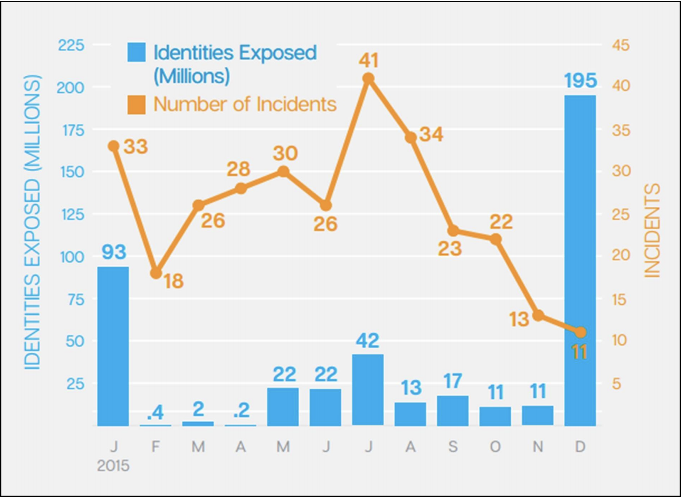
Identity Attacks Rising
Attacks targeting identities are rising everyday
The following graph shows the number of identities that have been exposed compared to the total number of incidents
Source: Symantec Internet Security Threat Report (2016)
Notes:
The number of attackers that are targeting identities are rising everyday. As you can see from this graph, even though the number of incidents has been decreasing since the beginning of 2015, the number of identities exposed reached an all time high towards the end of 2015.

Slide 13
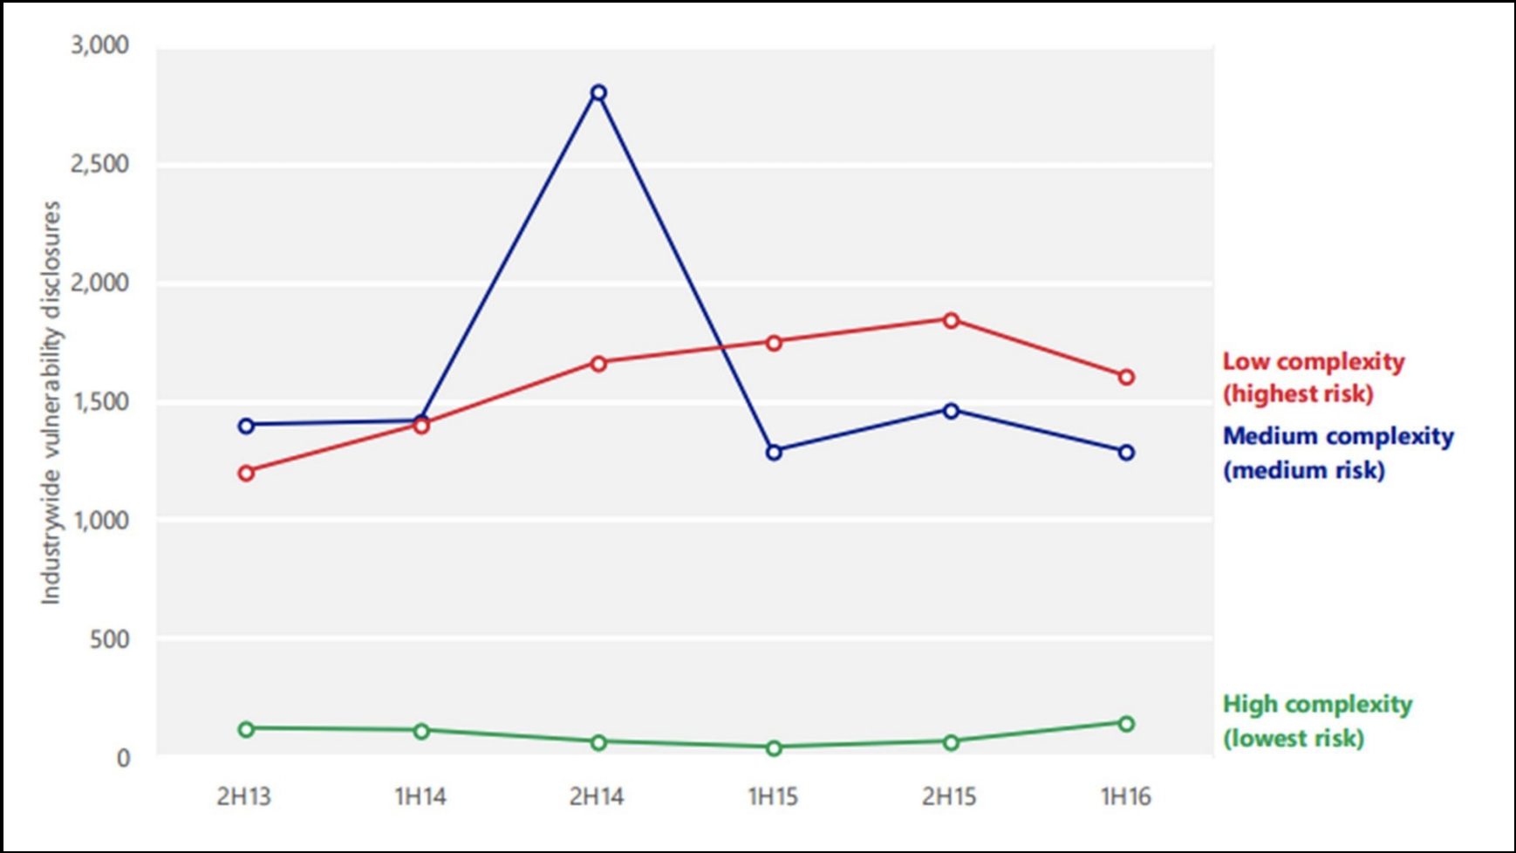
Complexity of Vulnerabilities
The most common response of engineers behind the attacked system is to say that the attack was very complex and sophisticated, but that is usually not the case
The following graph shows that most vulnerabilities in software that attackers find are not complex
Source: Microsoft Security Intelligence Report Volume 21 ( January through June 2016)
Notes:
The most common response of engineers behind the attacked systems is to say that the attack was very complex and sophisticated, but that is usually not the case. This graph shows that most vulnerabilities in software that attackers find are of low or medium complexity, and that high complexity attacks are much less common.

Slide 14
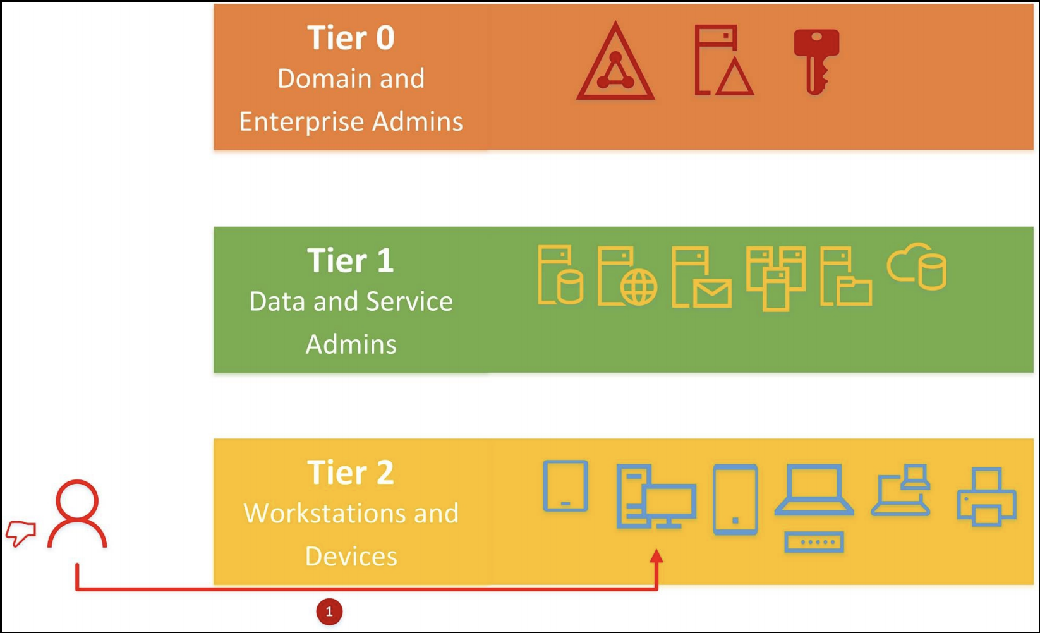
A Typical Identity Infrastructure Attack
The Microsoft tiered administration model is based on 3 tiers
Identity attacks generally start by gaining some sort of access to the infrastructure and then moving laterally until the desired privileges are obtained
Source: Mastering Active Directory, Dishan Francis
Notes:
Lets now look through a typical identity attack within an infrastructure. But first, we must understand the Microsoft tiered administration model. The model is based on 3 tiers, tier 0, 1, and 2. Tier 2 is the level that contains computer workstations and devices. Tier 1 contains data and service admins, and tier 2 contains domain and enterprise admins. Identity attacks generally start by gaining some sort of access to the infrastructure and then moving laterally until the desired privileges are obtained.

Slide 15
A Typical Attack
The first step is to get some type of access into the identity infrastructure system
Attackers go after typical user accounts first as they are much easier to get access to as opposed to a domain/enterprise admin account
  A phishing email is a common attack method to gain access to a normal user account
Many admins, in bad practice, give typical users admin privileges as an easy solution to allow them to perform a necessary task
  This leaves many typical user accounts with the privileges of an admin right off the bat
Notes:
The first step is to get some type of access into the identity infrastructure system. Attackers go after typical user accounts first as they are much easier to get access to as opposed to a domain/enterprise admin account. A phishing email is a common attack method to gain access to a normal user account, and entails the user putting their account information to some type of false system. Also, many admins, in bad practice, give typical users admin privileges as an easy solution to allow them to perform a necessary task. This leaves many typical user accounts with the privileges that the attacker is after right off the bat.

Slide 16
A Typical Attack (cont.)
If the user does not already have privileges needed to get to the next tier, an experienced attacker can easily get them
  A common tactic is to set up a password harvesting tool and make the system fail, requiring an IT admin with administrator privileges to come login and have their username and password harvested
These simple attacks get many attackers the privileges that they are after
Notes:
If the user does not already have privileges needed to get to the next tier, an experienced attacker can easily get them. A common tactic is to set up a password harvesting tool and make the system fail, requiring an IT admin with administrator privileges to come login and have their username and password harvested. These simple attacks get many attackers the privileges that they are after.

Slide 17
After They Have Access
The latest reports show that after an initial breach, it takes less than 48 hours on average to get access to tier 0
It usually takes at least 7 or 8 months to identify the breach
  Once the attacker has full privileges, it is easy for them to hide themselves by creating backdoors into the infrastructure or cleaning up logs
The systems we use trust admin accounts as trustworthy people, but this should no longer be the case
Notes:
The latest reports show that after an initial breach, it takes less than 48 hours on average to get access to tier 0. In addition, it usually takes at least 7 to 8 months to identity the breach. Once the attacker has full privileges, it is easy for them to hide themselves by creating backdoors into the infrastructure or cleaning up logs. The systems we use trust admin accounts as trustworthy people, but this should no longer be the case.

Slide 18
IT Professional Concerns
The root of this vulnerability comes from IT professionals managing the permissions of user accounts
  It is too easy for someone to take the easy path and just assign someone admin privileges
Common comments from IT professionals on infrastructure identity security
  “We have too many administrator accounts.”
  ”We don’t know how many administrator accounts we have.”
  ”We have fast changing IT teams, so its hard to manage permissions.”
  ”We don’t have visibility over administrator account activities.”
The answer to all of these concerns is Privileged Access Management (PAM)
Notes:
The root of this vulnerability comes from IT professionals managing the permissions of user accounts. It is too easy for someone to take the easy path and just assign someone admin privileges. Common comments from IT professionals on infrastructure identity security include “We have too many administrator accounts,” “We don’t know how many administrator accounts we have,” “We have fast changing IT teams, so its hard to manage permissions,” and “We don’t have visibility over administrator account activities.” The answer to all of these concerns is Privileged Access Management.

Slide 19
References
EMC Education Services. 2012. Information storage and management: storing, managing, and protecting digital information 2nd ed., Hoboken, NJ: Wiley.
D. Francis, Mastering Active Directory. Birmingham: Packt, 2017.
Internet Security Threat Report. (2016). [ebook] Symantec, pp.49, 53. Available at: https://www.symantec.com/content/dam/symantec/docs/reports/istr-21-2016-en.pdf [Accessed 27 Mar. 2018].
Microsoft Security Intelligence Report. (2018). [ebook] Microsoft, p.46. Available at: https://download.microsoft.com/download/E/B/0/EB0F50CC-989C-4B66-B7F6-68CD3DC90DE3/Microsoft_Security_Intelligence_Report_Volume_21_English.pdf [Accessed 27 Mar. 2018].

