Slide 1
Active Directory Security Best Practices
Chapter 15:
Cyber Threats & Kerberos
Key Distribution Center
Kerberos Authentication (Review)
Permissions
Fine-grained Password Policies
Pass-the-hash Attacks
Protecting Highly Privileged Accounts
JIT and JE Administration

Slide 2
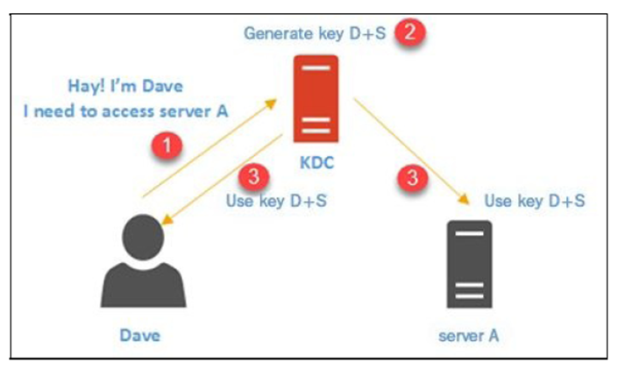
Key Distribution Center (KDC)
Key Distribution Center is the trusted authority for distributing the symmetric keys
Key Exchange (How it works)
Dave requests access to Server A through the Key Distribution Center
The key provided should be used only by Dave and Server A
KDC accepts the request and generates a key (key Dave+Server)
This key is then distributed to Dave and Server A
For Server A to accept Dave’s connection it must store key D+S
If there are hundreds of connections
The server stores all those keys as well
This will cost resources for Server A

Slide 3
Key Distribution Center in AD environment
In an AD environment the KDC is installed as part of the domain controller
Is responsible for 2 main services
Authentication Service (AS)
Ticket-Granting Service (TGS)
Notes:
Authentication Service (AS) facilitates username and password validation using an on-premises Active Directory server. This component is not relative to the upcoming explanation of TGS. However, it is a primary part of the Key Distribution Center.
Also note, that the KDC is a part of the domain controller. In future examples and review, the KDC is referenced as only the domain controller, which may confuse students who initially learn that DC stands for distribution center. (In this case they are referencing the same thing)

Slide 4
Ticket-Granting Service (TGS)
Each time Dave logs in, he needs to prove to the Key Distribution Center he is the person he claims to be
This is done by using a long-time cryptographic key
Generated based on Dave’s password by the Kerberos client on Dave’s PC
Key Distribution Center keeps a copy of this key as well
When logging in, Dave sends his username and long-time key
Key Distribution Center compares this to its records
If valid, Key Distribution Center responds to Dave with a session key
This is called a ticket-granting ticket (TGT)
Notes:
Students should be informed that there will be a review section which displays the numbered step by step process of a user attempting to connect to a server following this section. Advise them to focus on taking notes instead of grasping the entire concept. The review section is a bit more simplified and students can apply their notes there to fully understand the process. There will be 7 steps.

Slide 5
Ticket-Granting Ticket (TGT)
Ticket-Granting Ticket contains 2 things:
A copy of a session key that the Key Distribution Center uses to communicate with Dave
This is encrypted with the Key Distribution Center’s long-term key
A copy of a session key that Dave can use to communicate with the Key Distribution Center
This is encrypted with the Dave’s long-term key so only he can decrypt it
Once Dave receives this key, he can decrypt it using his long-term key
This results in the session which is used for all further communication with Key Distribution Center
Session keys are temporary and have a time to live (TTL) value
The session key will be stored in Dave’s PC’s volatile memory

Slide 6
Session Key Obtained
Dave can now request access to Server A
Must contact Key Distribution Center again this time using the session key
The request includes the Ticket Granting Ticket, timestamp encrypted by the session key, and the service ID (The service running on Server A)
Once Key Distribution Center receives the request it uses its long-term key to decrypt the Ticket Granting Ticket and retrieve the session key
Using the session key it decrypts the timestamp
If the time difference is less than 5 minutes it proves it came from Dave

Slide 7
Service Ticket
Key Distribution Center confirms its a legitimate request and creates another ticket
This ticket is called a service ticket
Contains 2 keys, one for Dave and one for Server A
Both keys include
The requester’s name (Dave)
The recipient
The timestamp
The Time To Live value
A new session key (that will be shared between Dave and Server A)
One of these keys is encrypted using Dave’s long-term key
The other encrypted by Server A’s long-term key
In the end, both keys are encrypted together using session key between KDC and Dave
After this is complete the ticket is sent to Dave
Dave decrypts the ticket using the session key
And decrypts ‘his’ key using his long-term key

Slide 8
Connecting to Server A
The previous decryption reveals the new session key shared between Dave and Server A
He then creates a new request to Server A including Server A’s key and the timestamp (encrypted using the new session key from the KDC)
Once received, Server A decrypts its key using its long-term key, retrieving the session key
Using the session key it decrypts the timestamp to verify authenticity of the request
Notes:
To note at the end of this, it is not Server A’s responsibility to track the key being used by the client, and it is not the clients responsibility to keep track of relevant keys.

Slide 9
Other Requirements for the Process
Connectivity:
The server, client, and KDC need to have a reliable connection between them to process requests and responses
DNS:
Clients use Domain Name System to locate the KDC and servers (thus a functioning Domain Name System with correct records is required)
Time Synchronization:
The process uses timestamps to verify authenticity of requests
Thus it is required to have accurate time synchronization with the domain controllers
Server Principal Names:
Clients use service principal names (SPN) to locate services in the AD environment
If there is no SPN for the services, clients and the KDC cannot locate them when required

