Slide 1
Active Directory Security Best Practices
Chapter 15:
Cyber Threats & Kerberos
Key Distribution Center
Kerberos Authentication (Review)
Permissions
Fine-grained Password Policies
Pass-the-hash Attacks
Protecting Highly Privileged Accounts
JIT and JE Administration
Notes:
Students should be informed that many terms are abbreviated for consistent use, and that it might be a good idea to make a reference notes page to keep all of the terms and their abbreviations together.

Slide 2
Common Threats
Based on 2016 Internet Security Threat Report by Symantec, the main reason for a majority of identity attacks are:
Phishing attacks
Viruses
Malware
Initial security breaches are not directly related to the Active Directory service
In an infrastructure there can be many Active Directory-integrated applications
They directly query AD Domain Services databases to authenticate users
Compromise of these applications or bugs can make backdoors for adversaries
Notes:
Phishing attacks, are when an adversary poses as a trusted group, requesting personal credentials such as account information or bank info. (I.E. An email from your bank, who’s name is proper but actually is completely unrelated)
Viruses/Malware, act in a similar way but are applications that have infected the users machine. They too often gather sensitive/confidential data or can attempt to damage the users machine. Viruses typically can replicate, spreading throughout systems and networks, infecting multiple machines.

Slide 3
Active Directory Authentication
AD uses Kerberos version 5 (authentication protocol, providing authentication between server and client)
Has become default authentication protocol for Windows Server
Provides interoperability with other systems using the same standards
Notes:
Kerberos will be explained in the following slides with an example of its application and its ability to side step current some known issues regarding user identification verification.

Slide 4
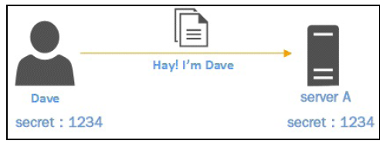
How does AD authentication work with Kerberos?
Kerberos protocol is built to protect authentication in an open network where other systems are connected
The main concept behind authentication is an agree upon password between two parties that is used to identify and verify authenticity
In this example Dave is attempting to contact Server A
Dave’s password is 1234
When the server receives contact
it checks the password, validating identity
if valid it continues communication

Slide 5
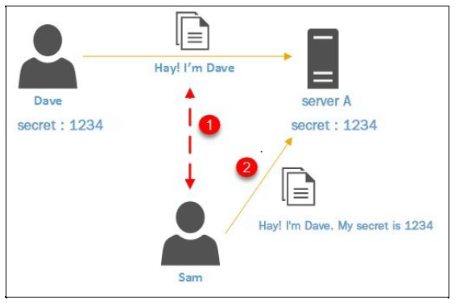
Kerberos
Communication between Dave and Server A is on an open network, meaning there are other connected systems
Sam in on this network, with interest in Dave’s data exchange
He observes traffic between Dave and Server A to find out the password
He then contacts Server A as Dave using 1234
From the servers view it sees no difference as Sam said he was Dave with the correct password

Slide 6
Kerberos
Kerberos solves this identity issue using a shared symmetric cryptographic key instead of secrets(passwords)
This key is used for encryption and decryption
Kerberos name stems from the 3-headed dog Cerberus of Greek mythology
The 3 heads symbolize 3 main components
A client
A server
A trusted authority to issue secret keys
Notes:
In the end, Kerberos is used to ensure identity of users within the infrastructure that AD is deployed in. Although this section defines Kerberos’s abilities, the following section will give a step by step scenario as to how Kerberos accomplishes them.

