Slide 1
Active Directory Rights Management Services (RMS)
Chapter 14:
What is AD RMS & Steps to Data Protection
Abilities & Boundaries of AD RMS
AD RMS Components
How does AD RMS work?
How does AD RMS work? (Review)
How do we deploy AD RMS?

Slide 2
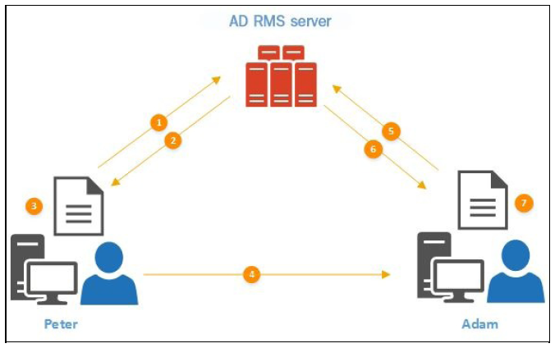
How does AD RMS work? (REVIEW) 1 of 7
This is the first time the Sender is using the AD RMS
Attempts to protect data cause the RMS client to initiate a connection to the AD RMS server (cluster)

Slide 3
How does AD RMS work? (REVIEW) 2 of 7
The AD RMS server replies with Rights Account Certificate (RAC) and Client Licensor Certificate (CLC)
Remember this is a ONE time process

Slide 4
How does AD RMS work? (REVIEW) 3 of 7
In the Senders system, a random symmetric key is generated and is used to encrypt the data
This key is encrypted using Server Licensor Certificate’s (SLC) public key
It is then attached to a Publisher License (PL) which includes the recipients rights for the protected data
The PL is then attached to the encrypted data

Slide 5
How does AD RMS work? (REVIEW) 4 of 7
The Sender sends the protected document with the additional info to the Recipient

Slide 6
How does AD RMS work? (REVIEW) 5 of 7
The Recipients RMS-aware application attempts to access the data, finding it needs the Use License (UL) from the AD RMS server
The RMS client makes a request for the UL from the server

Slide 7
How does AD RMS work? (REVIEW) 6 of 7
The RMS server decrypts the symmetric key and PL
Server checks whether requester matches the PL
If a match, the server generates the UL
Includes the symmetric key (re-encrypted with Recipients RAC public key), and the list of rights described in the PL
It is then delivered to the Recipients system

Slide 8
How does AD RMS work? (REVIEW) 7 of 7
Once the Recipient’s system receives the UL it retrieves the symmetric key and decrypts the data
The recipient can then view the data and use it according to the rights described in the PL

