Slide 1
Concepts of
Computing
Technologies
Directory and Access Management:
How to Set up a
Federation Server
It is recommended to follow along in the book for more details
Notes:
Replace this with your course title and your name/contact details.

Slide 2
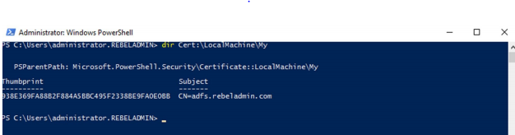
Install the AD FS Role
Before we can install AD FS the server must be issued an SSl certificate, we can check to see if this is done using
  dir Cert:\LocalMachine\My
  We can then install and configure AD FS with
  Install-WindowsFeature ADFS-Federation -IncludeManagementTools
  Import-Module ADFS $credentials = Get-Credential Install-AdfsFarm ` -CertificateThumbprint:"938E369FA88B2F884A5BBC495F2338BE9FA0E0BB" ` -FederationServiceDisplayName:"REBELADMIN INC" ` -FederationServiceName:"adfs.rebeladmin.com" ` -ServiceAccountCredential $credentials
  Where the Names in quotes are changed appropriately
Francis, D. (n.d.). Mastering Active Directory pg.643.

Slide 3
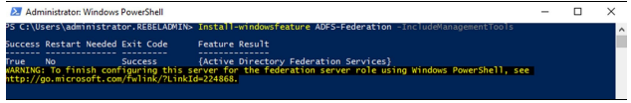
Results
Francis, D. (n.d.). Mastering Active Directory pg.643.
The above should be output after the above command
Then the system must restart and after so we run
  Get-WinEvent "AD FS/Admin" | Where-Object {$_.ID -eq "100"} | fl
To check to see if the installation was completed, if so event 100 will be printed

Slide 4
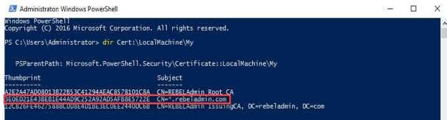

Installing the Web Application Proxy(WAP)
To install the WAP we need to use our SSL certificate again.
  dir Cert:\LocalMachine\My
Francis, D. (n.d.). Mastering Active Directory pg.646.
Then we need to install WAP
  Install-WindowsFeature Web-Application-Proxy -IncludeManagementTools
Francis, D. (n.d.). Mastering Active Directory pg.646.

Slide 5
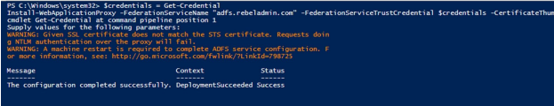
Configure WAP
After the installation is complete we can configure Ad FS with
  $credentials = Get-Credential Install-WebApplicationProxy -FederationServiceName "adfs.rebeladmin.com" -FederationServiceTrustCredential $credentials -CertificateThumbprint "3E0ED21E43BEB1E44AD9C252A92AD5AFB8E5722E"
The server will then need to restart
Francis, D. (n.d.). Mastering Active Directory pg.647.

Slide 6
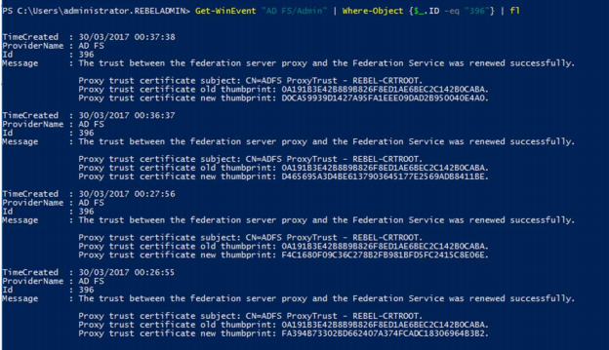
Confirmation
We can confirm that the installation was successful by running Get-WinEvent "AD FS/Admin" | Where-Object {$_.ID -eq "396"} | fl to get the event log
Francis, D. (n.d.). Mastering Active Directory pg.648.

Slide 7
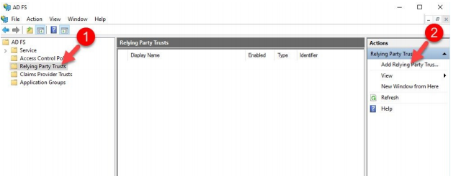
Creating a federation Trust
Log on as an administrator
Go to Server Manager>Tools>AD FS Management
Click on relying Party Trust and click App Relying Party Trust on the right
Francis, D. (n.d.). Mastering Active Directory pg.651.
The wizard will open, select claims aware and then start
Import data from application, this is acquired when requesting federation from an application
Follow the wizard and Configure the federation as appropriate per application and a federation is connecting your two servers

Slide 8
References
EMC Education Services. 2012. Information storage and management: storing, managing, and protecting digital information 2nd ed., Hoboken, NJ: Wiley.

