Slide 1
Concepts of
Computing
Technologies
Directory and Access Management:
How to Set up a
Stand-Alone Certificate Authority
It is recommended to follow along in the book for more details
Notes:
Replace this with your course title and your name/contact details.

Slide 2
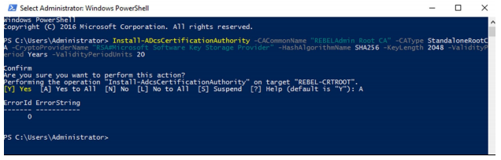
Set up Root CA
Francis, D. (n.d.). Mastering Active Directory pg.597.
Make sure the server is not a domain member, you are using a computer with windows server on it.
Add the Certificate Authority rolle by running Add-WindowsFeature ADCS-Cert-Authority - IncludeManagementTools
Then we need to configure the role with Install-ADcsCertificationAuthority -CACommonName "REBELAdmin Root CA" -CAType Standalone , where you would replace REBELAdmin Root CA with your desired name

Slide 3
Root CA Configuration
There are a few command that can be included in the configuration command that you can use to configure the root CA to your requirements:
  -CACommonName Defines the name of the server
  -CAType Defines the Type of the server, This can be followed by:
    EnterpriseRootCA
    EnterpriseSubordinateCA
    StandaloneSubordinateCA
  To specify the type
  -CryptoProviderName defines which cryptographic service will be used
  -HashAlgorithmName Denotes which hashing algorithm to use
  -KeyLength Defines the size of the keys
  -ValidityPeriod defines how long of a period a certificate issued by this CA is valid for

Slide 4
Setting up a service to get CAs
Now we need to setup a web service to acquire a certificate
We first need to install a web server with
  InstallWindowsFeature Web-WebServer -IncludeManagementTools
We then need to create a directory for Certificates with
  mkdir C:\CertEnroll
  New-smbshare -name CertEnroll C:\CertEnroll -FullAccess SYSTEM,"rebeladmin\Domain Admins" -ChangeAccess "rebeladmin\Cert Publishers"
Then we can set up The public the CDP with
  certutil -setreg CA\CRLPublicationURLs "1:C:\Windows\system32\CertSrv\CertEnroll\%3%8%9.crl \n10:ldap:///CN=%7%8,CN=%2,CN=CDP,CN=Public Key Services,CN=Services,%6%10\n2:http://crt.rebeladmin.com/CertEnroll/%3

Slide 5
Setting up AIA location and generating a certificate for the root
Now we need a location where applications can acquire certificates and that can be acquired using
  certutil -setreg CA\CACertPublicationURLs "1:C:\Windows\system32\CertSrv\CertEnroll\%1_%
Now we need to generate a Certificate for the root and this can be accomplished by running certutil -crl

Slide 6
Setting up the issuing CA
Now that we have a root we can set up an issuing CA
  Will run from within the domain
  Integrated with Active Directory
First log onto the server and install the ADCS role with
  Add-WindowsFeature ADCS-Cert-Authority -IncludeManagementTools\
Then we install web services for enrollment
  Add-WindowsFeature ADCS-web-enrollment
Then we configure Certificate Authority
  Install-ADcsCertificationAuthority -CACommonName "REBELAdmin IssuingCA" -CAType Enterprise
Finally install the enrolment Service
  Install-ADCSwebenrollment

Slide 7
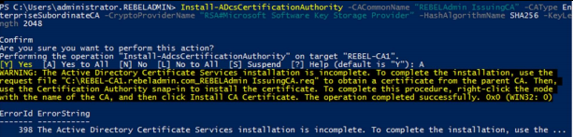
Issuing a Cert to the Issuing CA
Now we need to give the Issuing CA a certificate so it can be legitimized by the root CA
The request process is handled for us when we configure the server and the file name is listed in from it but we need to submit the request with
  certreq -submit "REBEL-CA1.rebeladmin.com_REBELAdmin IssuingCA.req"
Where the file name is the same as the one printed out after configuration
Francis, D. (n.d.). Mastering Active Directory pg.597.

Slide 8
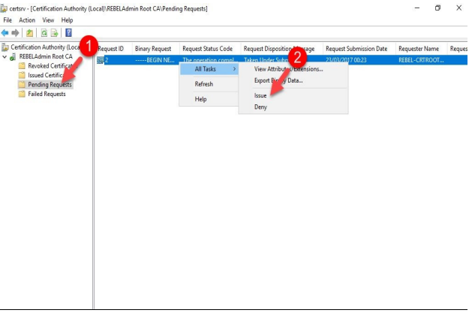
Accepting the Request
Francis, D. (n.d.). Mastering Active Directory pg.598.
Once the request is sent we then need to log into out root CA and accept the request by going into ServerManager>Tools>Certificate Authority>pending requests and issuing the certificate.

Slide 9
Retrieve the Certificate
Now we need to log back into the issuing CA and retrieve the accepted with
  certreq -retrieve 2 "C:\REBEL-CA1.rebeladmin.com_REBELAdmin_IssuingCA.crt"
  With the name of the file being your file name you requested
Then move the .crt file into into the issuing CA then run
  Certutil –installcert "C:\REBELCA1.rebeladmin.com_REBELAdmin_IssuingCA.crt" start-service certsvc
Then your Certificate Authority is all good to go, you may a few more commands to configure the CA further
  certutil -setreg CA\CRLPublicationURLs "1:%WINDIR%\system32\CertSrv\CertEnroll\%3%8%9.cr for CDP location
  certutil -setreg CA\CACertPublicationURLs "1:%WINDIR%\system32\CertSrv\CertEnroll\%1_%3% for AIA locations

Slide 10
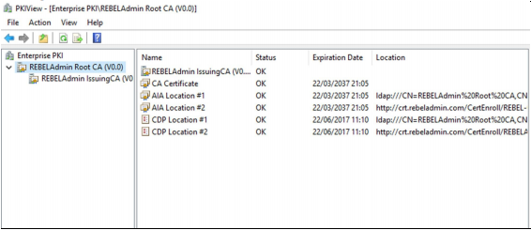
Generate CRLs
Finally we run
  certutil -crl
This will generate all of the CRLs required we can check to see if everything went right with PKIView.msc
Francis, D. (n.d.). Mastering Active Directory pg.602.

Slide 11
Requesting a Certificate
To request a certificate run
  MMC
  add/remove snap-in
  Certificates
  Click add
  Right click on personal
  Request a certificate
  Follow wizard to request a certificate from your CA

Slide 12
References
EMC Education Services. 2012. Information storage and management: storing, managing, and protecting digital information 2nd ed., Hoboken, NJ: Wiley.

