Slide 1
Concepts of
Computing
Technologies
Directory and Access Management:
Federation Services Architecture
Notes:
Replace this with your course title and your name/contact details.

Slide 2
Objectives
By the end of this lesson, you should be able to:
Understand the basic components of Federation Services.
Know what a web application proxy is.
Understand The different ways to set up federation services.

Slide 3
Components
Federation Service- The service that will handle tokens (SAML asserts) and claims
Web Proxy- The service that will handle incoming requests from external sources and reroute them safely to the Federation Service
AD Domain Services- a service to provide the identity of the user
Claims away agent- a service that keeps track of company claims
Windows token based agent- a service that keeps track of tokens

Slide 4
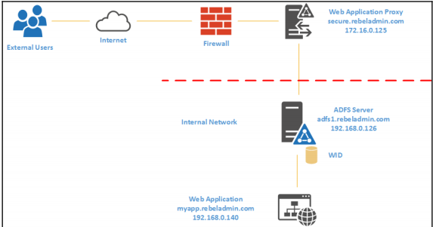
AD FS Major Players
Federation Service
  Claims provider
  Secure Token Server
  Needs to be part of a domain
  Communicates between Identity Provider and Service Provider
  Multiple under the same Domain this is called a Federation Server Farm
Web Application Proxy
  Used to communicate to internet on behalf of internal users.
  Protects users
  Is recommended
  Communicates between Application Service and FS
Domain Controller
  Identity Provider
  Attribute Store
Application Service
  Service/Application Provider
Francis, D. (n.d.). Mastering Active Directory pg.634.

Slide 5
Database Configuration or Choices for your Federation Service
Since Active Directory Federation Services needs to keep track of claims and tokens it is important that these claims and tokens need to be kept track of in a database. There are two ways to go about this:
Windows Internal Database(WID)
  Not a standalone database and is installed with AD FS
  Can provide high availability
  Can be copied to other AD FS servers so it is scalable
  First one will be primary ADFS server and will provide its information to other AD FS Servers.
  Non Primary AD FS servers will be read only though
  Only primary can be configurations must go through primary
Microsoft SQL
  All servers can then read and write
  Higher efficiency
  High Availability
  Must be always one

Slide 6
Deployment Topology:Single Server
With WID
Single Server
  Simple with WID
  Low availability and performance
  Needs DNS for routing
  Should set up Network Load Balancer for scalability
  Pros
    Low cost
    Easy Management
    No additional services
    Can expand
  Cons
    Single point of failure
    Poor performance
    Less secure

Slide 7
Deployment Topology:Single Server & Proxy
With WID
Single Server and Proxy
  Ideal start up
  Less of a security hazard
  Proxy is initial contact
  Can use NLB
  Pros
    Improved Security
    Basic DOS protection
  Cons
    Single point of failure
    Higher cost
    More dependencies

Slide 8
Deployment Topography: Many Federation Servers and Proxies
Multiple Federation Servers and Proxies
  Each server has NBL clusters
  Sql always on environment
  Proxy initial contact
  Pros
    High Availability and Performance due to many servers and proxies
    Supports SAML artifact resolution and SAML/WS-federation token replay detection
  High cost
  Complex
  High maintenance

Slide 9
References
EMC Education Services. 2012. Information storage and management: storing, managing, and protecting digital information 2nd ed., Hoboken, NJ: Wiley.

