Slide 1
Concepts of Computing Technologies Directory and Access Management: Federation Services
Notes:
Replace this with your course title and your name/contact details.

Slide 2
Objectives
By the end of this lesson, you should be able to:
Know what Federation Services are used for
Know why Federation Services is used
Know the process Federation Services uses

Slide 3
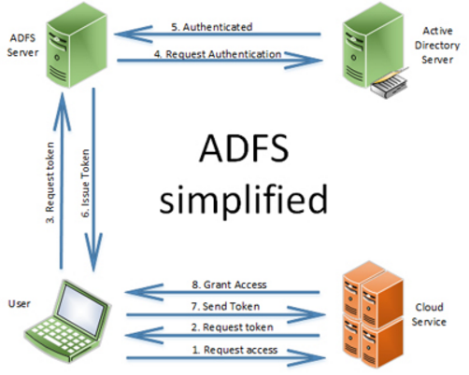
Terms
AD FS- Active Directory Federation Services
Application Server- service of the application a user is trying to access
Organization Server- Server of organization the user is a part of.
Access Rights- information containing what resources a user can access.

Slide 4

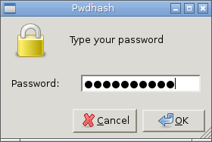
Federation Services
In today's world, we as individuals manage a lot of accounts. We have many usernames, many passwords, and sometimes many accounts for the same service. We already know how annoying this can be at times to manage all of this, but imagine a network admin who has to keep track of alot of these accounts for a bunch of people. Imagine a company like microsoft word who has to store a bunch of passwords and usernames for internal and external Identification. This is where Federation Services Comes in handy.

Slide 5
Federation Services
Federation Services allow an organization to keep track of it’s own identity infrastructure and instead of keeping track of third party accounts, we use claims-based authentication to manage its applications and resources. Federation Services has many advantages:
Administrators do not need to keep track of external accounts when new employees are acquired and termination.
Services do not need to keep more records about usernames and logins.
Users do not need to remember external usernames and passwords.
Access to services can be instant .
Claim based services can be used.

Slide 6
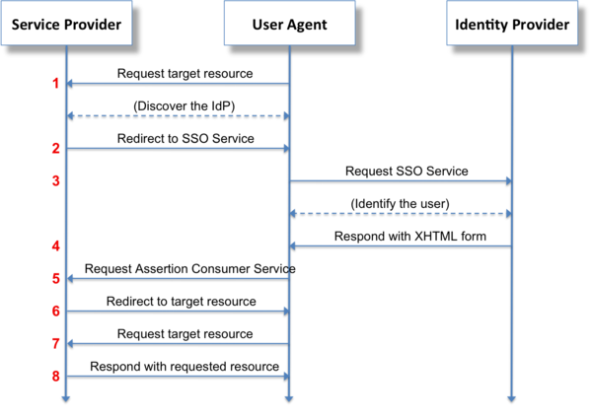
Claims
Claims are simply an attribute like a username and a relative value declaring what kind of service the user has a right to.
For example the attribute could be a username and an access code allowing them access to the resource, if the Service Provider does not understand the claim it doesn’t allow access.
When you log into Microsoft Word through your student account you give Microsoft a Claim as a student that you can access microsoft word, this is provided by the Rowan Federation Server.

Slide 7
Integrated Windows Authentication(IWF)
This process bypasses login when trying to access company resources from inside the network because it recognizes your login on the machine within the network and accepts that as your identification.

Slide 8
Example
When using Federation Services the following situation could occur:
Say you are a member of an organization that uses AD FS and you would like to use microsoft word, you go to the site for MS Word and try to log in. When you do this you are booted back to a proxy for your organization, you sign in with your organization email and password and are then brought back to MS Word and have access. This is what makes Active Directory directory service so important, ease of access and management.
Without Federation Services you would have to request a MS Word account, a new username and password would have to made for you and upon your unfortunate termination your account would have to be manually deleted.

Slide 9
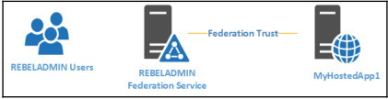
Two ways to go about Federation Services
User account of organization
When trying to access resources, you are then asked for login information and then verified with the AD FS server. This is what we talked about before.
AD trust between two infrastructures
While this takes more time and is more complex a trust can be established between the application Server and organization server. This then saves time by allowing the the application server to check directly with the Federation Server instead of going through the proxy and sending a claim back.
Francis, D. (n.d.). Mastering Active Directory pg.614.

Slide 10
Federation Trusts
As with both previous examples the core issue is security and how to go about it, the best way is to establish trusts, however these aren’t like Domain or Tree Trusts like we’ve seen before.
FS Trusts require a Identity Provider and a Service Provider. The former is within the organization and provides authentication and the latter is the service which takes in claims in exchange for service. So these trusts are different in the way that they only fulfill their roles to allow access to resources and do not have access to each other infrastructures as seen before or anything further than what they are needed for. The service provider can only check to see if an Identification is valid and do nothing else with it.
Francis, D. (n.d.). Mastering Active Directory pg.614.

Slide 11
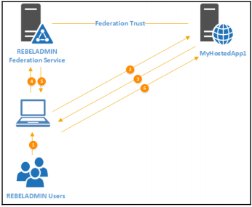
Process
User logs into internal device successfully.
User logs into an application on web browser which is hosted in a remote domain.
The application server realizes that the user is trying to log in from a remote infrastructure, but one with which this application has a federation relationship with. Sends redirect request.
User is redirected to their organizations FS web interface and they log in.
Francis, D. (n.d.). Mastering Active Directory pg.615.

Slide 12
Process
5. User is verified by AD Domain Services and access rights are retrieved. The Federation Services Server is then sent that information and the Server then generates a Security Token that is signed by the issuers digital Certificate. This token contains the user’s claims, group memberships, UPN, and email address. The server then sends this token back to the user with a redirect command to the service they were trying to access
6. User is redirected to application and their token is accepted and verified and based on the users claims they will be granted access.
Francis, D. (n.d.). Mastering Active Directory pg.615.

Slide 13
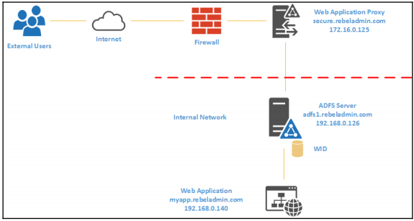
External Process
When accessing the Federation Services externally something different happens, before you get into the federation server you need to access the proxy which will then redirect you safely to the federation server. In this case the use of SAML is used to verify a users claim to a service.
Francis, D. (n.d.). Mastering Active Directory pg.634.

Slide 14
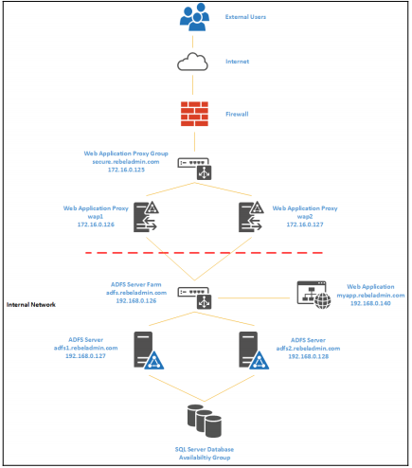
External Process
Francis, D. (n.d.). Mastering Active Directory pg.637.
Notes:
Likewise as before a user tried to log in from a remote location away from the infrastructure and is redirected to the federation server. They are then sent to the web application proxy server, that server then safely communicates to the federation server, the federation server then checks the Identity provider for claims and verification, that information is sent back to the federation server then the proxy and then to the user and the user is able to access the web application.

Slide 15
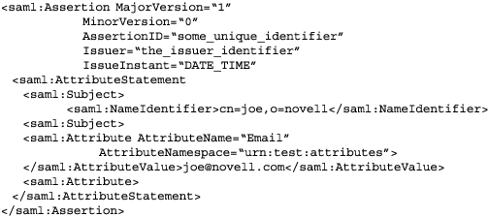
Security Assertion Markup Language(SAML)
This is the language used when the federation service is exchanging it’s token with the Service provider, it is in a standard format and allows for the single sign on experience.
When generating tokens are called asserts in SAML and processing the token is called an assertion.
Format used in Active Directory Federation Trusts.
When a SAML is generated it is passed into the web browser url when sending information to the application.

Slide 16
WS-Trust and WS-Federation
WS-Trust
The Web Service-Trust defines a set of protocol used when requesting and issuing tokens.
Part of WS-Trusts is the Security Token Services which allows tokens to be converted from one format to another.
WS-Federation
A Service used to simplify communication between the Identity Provider and the Service Provider by helping Tokens to be unified under one format.

Slide 17
References
EMC Education Services. 2012. Information storage and management: storing, managing, and protecting digital information 2nd ed., Hoboken, NJ: Wiley.

