Slide 1
Concepts of
Computing
Technologies
Directory and Access Management:
Certificate Authority Configuration and Infrastructure
Notes:
Replace this with your course title and your name/contact details.

Slide 2
Objectives
By the end of this lesson, you should be able to:
How Certificates work in Active Directory
Certificate Authority Hierarchy
How to obtain Certificates
Types of Certificate authorities
Certificate options
Architecture of Certificate Authorities

Slide 3
Terms
Objects- A general reference to entities within a company such as users, devices, and network devices.
CA- Certificate Authority
SCEP- Simple Certificate Enrollment Protocol- a simple protocol used to issue certificate to network devices

Slide 4
Certificates in Active Directory
In Active Directory Certificates are issued by Issuing Certificate Authorities to Users ,Devices, Services and Network Devices. They are trusted automatically internally but can be trusted externally as well.
Certificates obtained by the user is stored in the Certificate store
Certificates obtained by computers are also stored in the Certificate Store
Services are not given Certificates Directly, but instead users or computers are given certificates associated with them.
Certificate templates should be changed to suite the object type

Slide 5
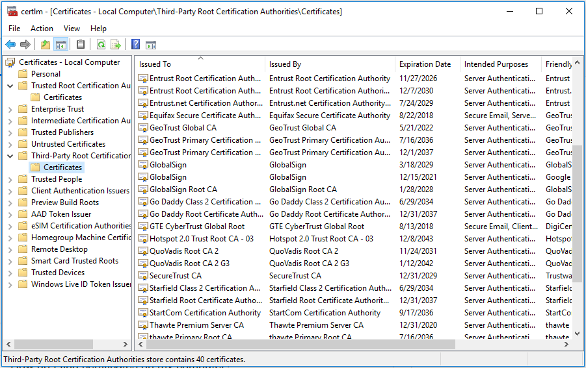
Certificate Template
Certificates start with a default template, but if you want improved security you can can some attributes about them.
What can be changed about the Certificate Template?
Cryptography Key Length
  Longer is better though takes more time to generate, encrypt, and decrypt.
Hashing Algorithms
  By default it is SHA256
Validity Period
  Up To Admin, through recommend short for user and longer for computer
  Cannot be changed once Issued

Slide 6
Certificate Acquisition
A user can obtain Certificates in many ways, Certificate Authorities can issue Certificates through:
Certificate Enrollment Web Services:
  Certificates Authorities obtain Certificates through web browser
  Certificates can be obtained outside the Corporate Network
  Can Take Template based Requests
  Auto Enrollment can be used for in-Domain Devices
Certificate Enrollment Policy Web Service:
  Like Certificate Enrollment Web Services but specifically for non domain computers.
Certificate Authority Web Enrollment:
  Similar to the CEWS however Acquisition is through an interface
  Can be used to obtain higher CA certificates

Slide 7
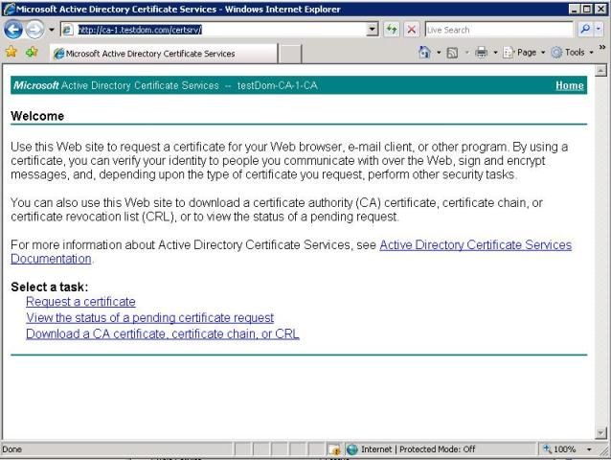
Certificate Acquisition Con’t
Network Device Enrollment Services
  Using the SCEP it allows network device to have Certificates issued to them
  Certificates for Network device help secure traffic
Online Responder
  A utility used to verify the status of certificates, it checks to see if a Certificate is out of data, revoked or legitimate.

Slide 8
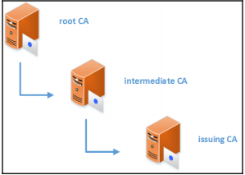
CA Hierarchy
There are Two types of Certificate Authorities:
The Root Certificate Authority
  Most trusted
  Issues and Renews Certificates to Certificate Authorities
  Needs to be the most secure
  Should only issue Certificates to Certificate Authorities
  Only One Root CA
  has a longer validity period
  Can have Subordinate CAs
Francis, D. (n.d.). Mastering Active Directory pg.558.

Slide 9
CA Hierarchy
The Subordinate Certificate Authority
  Issues Certificates to Objects or Services, known as Issuing CA
  Can be Multiple Subordinate CAs
  Has Certificate from root CA giving it Validity, though it can expire it odes have a longer validity period
  Can have Subordinate CAs, if it does have subordinate CAs it is known as a Intermediate CA
Francis, D. (n.d.). Mastering Active Directory pg.558.

Slide 10
Enterprise vs. Standalone CAs
Standalone CA
  Includes root CAs
  Issues to subordinate CAs
  Stays OFFLINE
  Manual Certification Issuing and acceptance
  These CAs are used to issue to other CAs and tend to be offline for security reasons, helps the CA structure function
Enterprise CA
  Requires less manpower
  Cannot be offline
  Auto enrollment
  Auto Approval
  These CAs are used to issue certificates to objects and services, They help the business function

Slide 11
Certificate Architecture
When building a Certificate Architecture There are a few things to Consider:
Availability
  You want a high availability so that issuing and verifying Certificates can run smoothly
Certificate Templates
  Choose Certificate Templates That Are right for your company and right for your objects, IE. certificates for employees have a shorter validity date when compared to devices
Boundary
  How far does the CA reach
  Should this CA operate outside of it’s domain or tree?

Slide 12
CA Models
There are many ways to structure a CA, ranging from simple to complex, from cheap to expensive, CAs should be structured to fit the company. The following are a few standard models for a CA.
One Tier Model
Two Tier Model
Three Tier Model

Slide 13
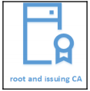
Certificate Authority Models
Single Tier - A single CA that acts as both the root and Issuing CA
  Pros
    Simple
    Cheaper
    Easy to deploy and manage
  Cons
    Not recommended for production networks
    Vulnerable
    Root CA is Issuing CA
    Not scalable
    High Workload
Francis, D. (n.d.). Mastering Active Directory pg.577.

Slide 14
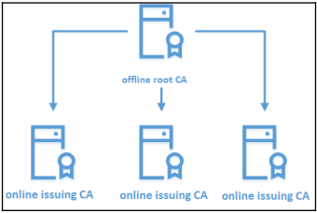
Certificate Authority Models
Two Tier Model - A root CA with Issuing CAs
  Pros
    Most Commonly Used
    Root CA is offline and safer
    Compromise of Expense and Management
    Root CA issues to Issuing CAs
    Issuing CAs Issue Certifications to objects
    Root CA does not need to be a domain Member
    Is Scalable
    Higher Security
    Improved Performance
    Flexible Maintenance
  Cons
    Renewing Issuing Certificates is a manual process
    Higher Maintenance
Francis, D. (n.d.). Mastering Active Directory pg.579.

Slide 15
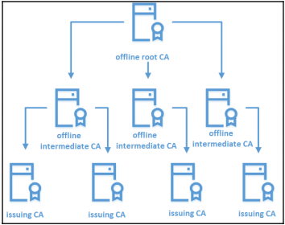
Certificate Authority Models
Three Tier Model - A root CA with Intermediate and Issuing CAs
  Higher Cryptography Potential
  Root and Intermediate CAs are standalone CAs
  Root issues to intermediate and intermediate issue to issuing
  Pros
    Improved security
    High performance
    Good boundaries
    Improved control
    High availability
  Cons
    High cost
    High maintenance
    complex
Francis, D. (n.d.). Mastering Active Directory pg.581.

Slide 16
References
EMC Education Services. 2012. Information storage and management: storing, managing, and protecting digital information 2nd ed., Hoboken, NJ: Wiley.

