Slide 1
Concepts of Computing Technologies Directory and Access Management:
Certificate Authority
Notes:
Replace this with your course title and your name/contact details.

Slide 2
Objectives
By the end of this lesson, you should be able to:
Know what a Certificate is and what it contains
Know how to obtain a Certificate
Know what a Certificate Authority is
Know the different types of Certificate Authorities

Slide 3
Terms
Signing Algorithm- an algorithm used to hash a message

Slide 4

Certificates and Certificate Authorities (CA)
Last time we talked about how data is encrypted and transferred in the PKI, but that isn't all we need, who do we get these public and private keys from. How do we know if a public key is legitimate? How do we know when expires or is compromised?
The answer is Certificates and Certificate Authorities.

Slide 5
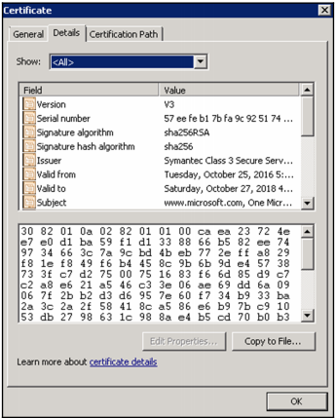
Certificate
A Certificate is kind of like a passport issued to users, computers, services and Network devices. It is a form of legitimate identification for a public/private key that can be verified with a known and trusted authority. They contain the following information:
Version of certificate (current version is x.509)
It’s serial number (unique Identifier)
A Signature Algorithm
Issuer
Valid From date
Valid To Date
Subject: who the Certificate was issued to
Public Key
Public Key
Francis, D. (n.d.). Mastering Active Directory pg.550.

Slide 6
Certificate Con’t
We can derive from Certificate contents, some important pieces of information:
Time limit: certificates have a time limit, they have a starting date and an ending date and any certificate that has past it’s date is no longer valid and must be renewed.
An Issuer: Someone can be contacted to verify the certificate
Subject: we know who this certificate is supposed to be for.
Serial number: each certificate is unique so that we know how to track it.
Francis, D. (n.d.). Mastering Active Directory pg.550.

Slide 7
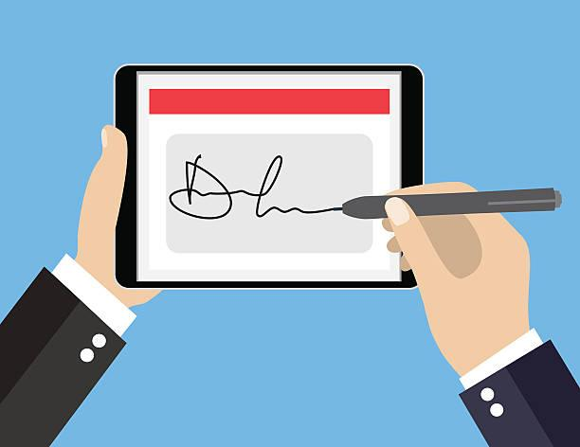
Certificate in Signing and Encryption
During signing process the certificate is used to retrieve the sender's private key and attach it’s public key to the sent information. As well as using the private key from the certificate for encryption.
During the decryption processes the recipient would have a certificate issued to them that contains the sender's public key and then they could compare the sent public key with their own to verify it’s data.
It is also good practice to check with the Certificate Authority to assure that the Certificate is still valid.

Slide 8

Certificate Uses
What else can Certificates be used for?
They can be used to Encrypt traffic between two peers in a Virtual Private Network
The can be used to Encrypt Files in the Encrypted File System
They can be used to Connect to Wireless Networks
Verification of Identity
Secure Communication
Used to Digitally Sign emails
Verify Installation Files
Prove Site Validity
Non-repudiation I.E. Since CA’s are trusted data signed with a Certificate from a trusted CA CANNOT be refused.

Slide 9

Certificate Authority
As we mentioned before about an issuer, someone is responsible for issuing certificates and and keeping track of their validity. They become something we can check with to assure that a certificate is valid, just like another country can check with your government to see if a passport is valid. They can:
Issue Certificates
Store Certificates
Manage Certificates
Revoke Certificates

Slide 10
Private vs. Public CA
A Private Certificate Authority is what you can set up in Activity Directory as an internal solution to certificate validation, however someone outside of the infustruction would have to explicitly trust your certifications.
A Public Certificate Authority is an entity that is trusted outside of your organization, most computers come with some pre-trusted public CAs. They have a higher security and are highly trusted, however to use these services you must pay for them, which can get expensive for a big company. Available to anyone.
Some examples are Comodo, Symantic, and GoDaddy

Slide 11
References
EMC Education Services. 2012. Information storage and management: storing, managing, and protecting digital information 2nd ed., Hoboken, NJ: Wiley.
Internet X.509 Public Key Infrastructure Certificate and Certificate Revocation List (CRL) Profile. (n.d.). Retrieved April 10, 2018, from https://tools.ietf.org/html/rfc5280#section-4.1.1.2

