Slide 1
Concepts of
Computing
Technologies
Directory and Access Management:
Public Key Infrastructure(PKI)
Notes:
Replace this with your course title and your name/contact details.

Slide 2
Objectives
By the end of this lesson, you should be able to:
Understand basic security protocols
Know what Symmetric and Asymmetric keys are
Know the difference between a Private and Public Keys
Understand encryption decryption and signing in PKI

Slide 3
Terms
Key- In Computer Security a Key is a unique value that is applied to a plaintext in order to encrypt it making it unreadable to anyone without the key.
Encryption- The processes of manipulating data to make it secure.
Decryption- The reverse of encryption, the process of making data readable that has been encrypted
Message- plaintext data

Slide 4

Symmetric key vs. Asymmetric keys
A Symmetric Key is used for Symmetric encryption, that is when data is encrypted using a Symmetric Key that data is then Decrypted using that same Key. The Same Key is used for Encryption and Decryption
Likewise an Asymmetric key is used for Asymmetric Encryption, this process uses a pair of keys to encrypt and secure data. When data is encrypted by one key the other key must be used to decrypt the data. The encryption method is one way, once you encrypt information with one key, you NEED the other key to decrypt it.
  Active Directory primarily uses a Two Key System for optimal Security

Slide 5
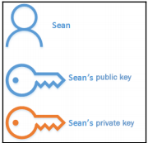
Public and Private Keys
As mentioned in Asymmetric encryption there are two keys used and these keys are given the following types:
  Public Key- A key that is given to the recipient of the data so that they may decrypt the data. It is known as a public because this key is out in the world and is more vulnerable. A public key can Decrypt any message Encrypted by the Private key and any message encrypted by the Public key can be decrypted by the Private Key.
  Private Key- A key that is kept with the user and is not given publicly, This key is NOT out in the world and is therefore safer. Any message Encrypted by the Private key can only be decrypted by the Public Key, and any message encrypted by the public key can be decrypted by the private key.
Francis, D. (n.d.). Mastering Active Directory pg.542.

Slide 6
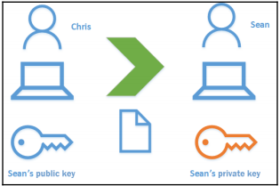
Digital Encryption
Data Transferred between two parties are secure because when the data is sent it will be encrypted by the public key, which is fine to give away. The data is then received by the other party and decrypted by their Private Key, if the data is intercepted they cannot decrypt the data even with the public key since it requires the private key to decrypt which is safe in the receiver's pocket.
Francis, D. (n.d.). Mastering Active Directory pg.542.

Slide 7
Digital Encryption
Imagine this as having a bunch of locks that all have the same combination whenever you want someone to send you something they lock it in a lockbox with one of your locks, but since only you know the combination only you can unlock the lockbox. Someone with a lock doesn't know the combination all they can do is close the lock.
Francis, D. (n.d.). Mastering Active Directory pg.542.

Slide 8
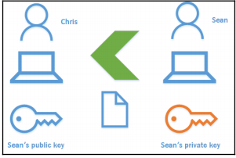
Digital Signing
What if someone doesn’t have a key pair and thus doesn't have a public key to give out but wants to make sure that information that they are receiving is from the right person and not a fake?
The answer to this is Digital Signing, In digital signing when the person holding the private key is encrypting data he encrypts it with his private key. That way only someone with a public key can decrypt it, but since only one person has the private key the the message could have ONLY come from that person.
Francis, D. (n.d.). Mastering Active Directory pg.544.
An import use of this system is when making online purchases as you aren’t part of the website PKI but you can be given a public key which you can use to make sure that information received is legitimate.

Slide 9
New Terms
Symmetric Keys- a one time key generated for the encryption process, can be generated faster than Asymmetric keys and is used to help security as using it in combination allows for less consistency in encrypted data.
Hashing-A one way algorithm that generates a non-reversible value based on the message that can be used to determine if a message was changed in transit since if it was the same hashing algorithm would produce a different result.
Message Digest-The result of Hashing a message.

Slide 10
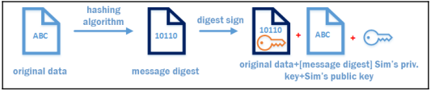
Using Encryption, Decryption, and Signing in PKI
When Sending data in the AD PKI it can be broken down into 2 stage: Signing and Encryption
Signing:
  System received data to be sent
  Message digest is generated using a hashing algorithm (Integrity)
  Encrypt the message digest using the sender's private key (Signing)
  Sender's Public Key is attached (for Decryption)
Encryption:
  Symmetric key is generated (for added security)
  Encrypt all signing data with Symmetric key (Encryption)
  Encrypt Symmetric Key with Receiver’s Public Key(so only receiver’s can decrypt it)
Francis, D. (n.d.). Mastering Active Directory pg.546.

Slide 11
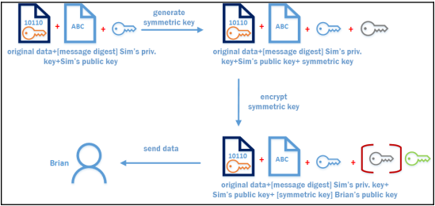
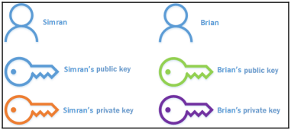
Using Encryption, Decryption, and Signing in PKI
Francis, D. (n.d.). Mastering Active Directory pg.546.
Notes:
The previous slide describes this process. Once a message digest is created and signed with the private key a symmetric key is created and then that key is then used to encrypt the data, we then encrypt all the data using the receiver's public key and send the data

Slide 12
Using Encryption, Decryption, and Signing in PKI (Cont’d)
Decryption:
  The Receiver starts by decrypting the Symmetric key using his private key
  The Symmetric key is used to decrypt the original data, the message digest and the sender's public key.
  The Symmetric key is discarded and isnt used again
  We use the sender’s public key to decrypt the message digest, which if you remember was encrypted using the sender's private key for signing purposes
  We hash the original message using the same algorithm and compare the received message digest with the newly generated one.
  If the Values are the same both the signing and Integrity are confirmed.

Slide 13
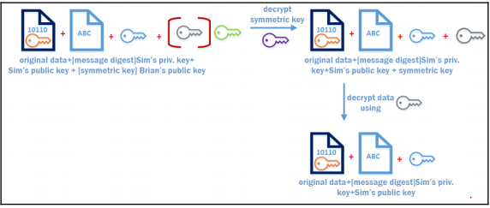
Using Encryption, Decryption, and Signing in PKI (Cont’d)
Francis, D. (n.d.). Mastering Active Directory pg.547.
The decryption process after the encrypted data is received by the user. Brian Decrypted using his private key, then decrypts using the Symmetric key and then has the encrypted message digest message and sim’s public key.

Slide 14
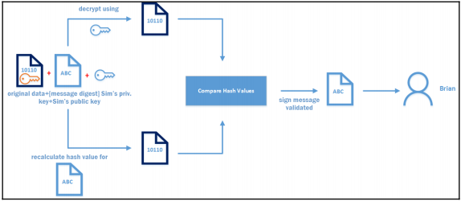
Using Encryption, Decryption, and Signing in PKI (Cont’d)
Francis, D. (n.d.). Mastering Active Directory pg.547.
After the data has been decrypted you have to check the validity of the data, we decrypt the message digest using sim’s public key validating the sender, then we check the digest against a new digest we created, if they match then we accept it

Slide 15
References
EMC Education Services. 2012. Information storage and management: storing, managing, and protecting digital information 2nd ed., Hoboken, NJ: Wiley.
http://searchsecurity.techtarget.com/definition/key
Internet X.509 Public Key Infrastructure Certificate and Certificate Revocation List (CRL) Profile. (n.d.). Retrieved April 10, 2018, from https://tools.ietf.org/html/rfc5280#section-4.1.1.2
Boneh, D., Crescenzo, G. D., Ostrovsky, R., & Persiano, G. (2004, May 02). Public Key Encryption with Keyword Search. Retrieved April 10, 2018, from https://link.springer.com/chapter/10.1007/978-3-540-24676-3_30

