Slide 1
Concepts of Computing Technologies Directory and Access Management: Group Policy Filtering, Processing and best practices
Notes:
201820-CS99310 - ADV LEARN ASST SEMINAR COM SCI (Section 1) – Spring 2018
Mantas Pileckis
Email: pileckism7@students.rowan.edu

Slide 2
Objectives
By the end of this lesson, you should be able to:
Have a basic understanding of filtering of group policies and the scope of which we can focus on while using group policy filtering.
Understand what Group Policy Preferences are and how they differ from Group Policy Settings.
Understand what loopback processing is.
Know some of the main practices when approaching the Group Policies.

Slide 3
Group Policy Filtering
Previously we discussed the implementation of group policies to specific sites, domains and organizational units using the LSDOU structure.
We can go beyond that and map the Policies to specific objects under these levels. Since the security, system or application settings are not always the same for each object. We call this method Group Policy Filtering.
Group Policy filter is simply the process of creating a new Group Policy Object (GPO) and linking it between the Organizational Unit.

Slide 4
Group Policy Filtering
By using the GPO’s we can narrow down the capabilities of the objects or users within our Organizational unit. We can either give them the benefits of the system or restrict their access.
The most common of use of filtering is perhaps locking down the functionality for users under a certain Organizational unit which is called Security Settings.
We can look at an example of Disabling the Task Manager feature.
Lets say we have a infrastructure with many employees, and some employees belong to a certain Organizational Units, but if we don’t trust those employees, we want to limit their functionality of using the Task Manager. To do this, we can simply create a new Group Policy Object and within it, we can enable the policy “Remove Task manager”. Once that is done, then we can simply link the Organizational Unit, or single Users from our infrastructure to that GPO.
There are many other uses of GPO’s, they range from anywhere of allowing Users/Objects to access certain folders, Control Panels, Running or Executing the executable files and so on.

Slide 5
Group Policy Filtering
Same way we can enable/disable functionalities to specific users, we can also do this to the workstations or computers in our infrastructure.
Windows Management Instrumentation (WMI) is the method of targeting specific objects within the infrastructure by using their attribute values. As an example, we can target specific computers under the infrastructure by targeting their operating system versions( 32 Bit/ 64 Bit).

Slide 6
Group Policy Filtering
So far we have covered three ways of filtering options, LSDOU, WMI and Security Settings. The order that these follow are:
LSDOU – The first filtering option will be based on the order in which policies are placed in the domain structure.
WMI filters – Once WMI filters are executed by the system, it will either apply and go to the next step or void the Group Policy.
Security Settings filter- The last step, it will look into security filtering and check whether the given security criteria have been met. If they are met, it will process the Group Policy.
Another thing to mention, The WMI filters can be tied up together with Security Setting Filter. This means that we can set up an GPO for a specific object, and if that object is in use, we can add on the Security Settings which are for a specific User of the domain. Or else, we can apply the Security Settings either way if the WMI is applied or not.

Slide 7
Group Policy Preferences
Group Policy preferences were first introduced with Windows 2008 to publish administrative preference settings to Windows Desktop operating systems and server operating systems. These preference settings can apply only to domain-join computers.
Group Policy preferences provide a granular-level targeting and also provide easy management via GUI.
They are used to replaced many Group Policy settings that requires registry edits or complex logon scripts.

Slide 8
Group Policy Preferences
Group Policy preferences are capable of adding/updating/removing settings such as :
Drive maps
Internet Explorer settings
Registry entries
Printers deployment
Start menu items
Power Management
Local users and groups
File replication
Managing VPN connections
Scheduled tasks

Slide 9
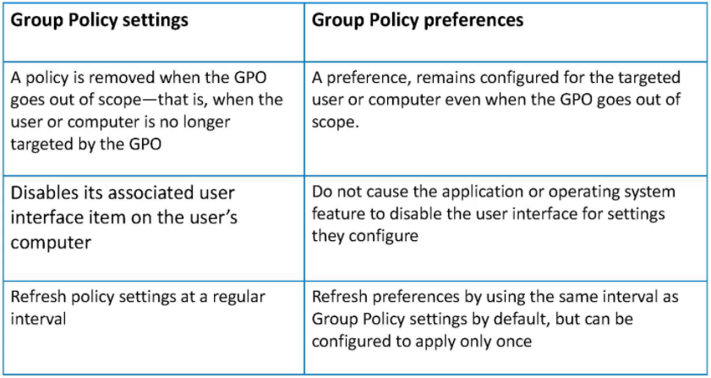
Group Policy Preferences
Group Policy settings and Group Policy preferences are processed in two different ways.

Slide 10
Group Policy Preferences
Group Policy settings are applied ruing the boot-up process and the user logon process. After that, settings are refreshed every 90 minutes by default.
Once Group Policy setting is applied, its values cannot changed easily. It is required to push new values via Group Policy, otherwise even if it’s changed, it will be overwritten in the next policy refresh cycle.
Group Policy preferences on the other hand are not enforced, they allow uses to alter them if required. This allows us to configure applications that are not Group Policy aware.
Group Policy preferences are also divided into Computer Configuration as well as User Configuration.

Slide 11
Loopback Processing
Group Policy mainly has two configurations. One is targeted at Computer Settings and another one is targeted at User Configuration. When we apply User Configuration to a user located in the Organization Unit, it doesn’t matter which computer they log in to; their policy settings will follow them.
There are cases where Group Policies needs to apply User Policy Settings based on the computer that the user logs into. For example :
Remote Desktop Services (RDS)
Applications such as Citrix Xenapp/Xen Desktop solutions.
These solutions are mostly open for login from remote networks. Therefor its security and operation requirements are different from computers in LAN.

Slide 12
Loopback Processing
Using Loopback Processing, we can force users to only have User Policy Settings that are linked to the Organizational Unit where computers are localed.
There are two modes of Loopback Processing:
Replace Mode: In the replace mode, user settings attached to the user from the original Organizational Unit will be replaced by the user settings attached to the destination Organizational Unit. Lets say a User logs into another station that they are designated to, that users settings will follow him where ever he logs into. For example, an administrator can log into any computer and have Administrative rights.
Merge Mode: In merge mode, the settings applied will be from the original policy where user belongs, and then the station policies will be applied. If there are any conflicting settings, the User Policies will be delegated first.

Slide 13
Group Policy Best Practices
In Active Directory environment, Group Policy related issues are the most painful and time consuming tasks as there are so many things that can go wrong. Therefor, here are some tips for good Group Policy design.
Identify the best place to link the Group Policy: Group Policies can be linked to the site, domain or organizational unit. It is important to understand the best place in the hierarchy to publish each Group Policy setting. This will prevent repetition and Group Policy conflicts. As an example of this, the password complexity settings are common for all the objects under the domain, therefor it should be define at domain root level, instead of the organizational unit.
Standardize settings: Todays infrastructure requirements are complex. Each business unit has its own operation and security requirements to address Group Policies. Always try to reduce the number of Group Policies that will be used in the system as when the number of Group Policies increases, it also increases the time to process during the login process.
**cited
Notes:
Francis, Dishan. “Group Policy Best Practices." Mastering Active Directory: Automate Tasks by Leveraging PowerShell for Active Directory Domain Services 2016. Birmingham: Packt Pub., 2017. 453.

Slide 14
Group Policy Best Practices
Use of meaningful names: Just like any other computer science related solution, the most important aspect of such complex tasks is the documentation. It is always a good practice to document, and comment everything in the Active Directory infrastructure to improve maintainability and troubleshooting.
Avoid mixing user settings and computer settings: Group Policy has two main configuration sets that will apply to users and/or computers. It is always a good practice to try to avoid mixing these settings under the same Group Policy. This will make the organizing of policies much more simpler and easier to use.
Use Group Policy enforcing and block inheritance appropriately: These features are a great way to managed the default Group Policy inheritance, but it can prevent users/system from having Group Policies applied since, the most policy settings comes from the domain level, and other parent levels of the Organizational Unit.
**cited
Notes:
Francis, Dishan. “Group Policy Best Practices." Mastering Active Directory: Automate Tasks by Leveraging PowerShell for Active Directory Domain Services 2016. Birmingham: Packt Pub., 2017. 454.

Slide 15
Group Policy Best Practices
Do not edit default policies: It is highly recommended to not edit the default policies because it is always a great place to fall back if something goes wrong with minimal effect. They also can be used as a reference to troubleshoot inheritance issues and replication issues.
Be careful when using loopback processing: Lots of issues related to loopback processing are due to lack of knowledge, especially when using replace and merge modes. It is recommended to create a separate Group Policy and name it appropriately so that IT’s understands it well when it comes to troubleshooting. It is also mostly recommended to only use replace mode when necessary. Try to avoid using merge mode as much as possible due to it can create a lot of gaps and hassles with combined Group Policies and their conflicted settings.
**cited
Notes:
Francis, Dishan. “Group Policy Best Practices." Mastering Active Directory: Automate Tasks by Leveraging PowerShell for Active Directory Domain Services 2016. Birmingham: Packt Pub., 2017. 454.

Slide 16
Group Policy Best Practices
Win or lose: We addressed how policies act between each other when they conflict. In theory, if the infrastructure is set up correctly, we should not have any conflicts at all. Therefore in the design stage of the Active Directory infrastructure, we should use filtering, inheritance and inheritance blocking frequently to prevent conflicts between policies.
Housekeeping: As discussed thru ought the previous chapters, it is always important to review the policies periodically and remove the policies that are not being used. Always perform audits on the hierchy and makes sure that the order is maintained and the objects are getting the expected group policies applied to them.
**cited
Notes:
Francis, Dishan. “Group Policy Best Practices." Mastering Active Directory: Automate Tasks by Leveraging PowerShell for Active Directory Domain Services 2016. Birmingham: Packt Pub., 2017. 455.

Slide 17
References
Francis, Dishan. Mastering Active Directory: Automate Tasks by Leveraging PowerShell for Active Directory Domain Services 2016. Birmingham: Packt Pub. 2017.
Microsoft. "Group Policy API." Group Policy API (Windows). N.p., 17 July 2016. Web. 11 Apr. 2018. <https://msdn.microsoft.com/en-us/library/aa374177(v=vs.85).aspx>.

