Slide 1
Concepts of Computing Technologies Directory and Access Management: Processing, Inheritance and Conflicts
Notes:
201820-CS99310 - ADV LEARN ASST SEMINAR COM SCI (Section 1) – Spring 2018
Mantas Pileckis
Email: pileckism7@students.rowan.edu

Slide 2
Objectives
By the end of this lesson, you should be able to:
Have a basic understanding of Group Policy Processing.
Have a basic understanding of Group Policy Inheritance.
Have a basic understanding of Group Policy Conflicts.

Slide 3
Group Policy Processing
Active Directory is only efficient if the structure is built on solid foundation, therefor it is very important to understand how Group Policy processing works.
When evaluating Group Policy requirements for an organization, we need to identify some settings that are common for objects in the same domain. But at the same time, some settings are unique to departments or specific groups. Any Group Policy that is applied at the root level will be inherited by other organization units by default. Therefor organization units can have inherited group policies as well as directly linked group policies.
In this case
Which Group Policy will be processed ?
Will it prevent any group policies ?
If the same setting is applied to different policies, which one will win ?
To answer these questions, we will have to understand the Group Policy processing first.

Slide 4
Types of Policies
There are mainly two types of policies in the Active Directory environment.
Local Policies
Windows systems are supported to set up local security policies. Their limited features focuses mostly on security settings. Local Policies are applied to any user who logs in to the system.
Non-Local Policies
These policies are Active Directory-based policies. These policies only apply to domain-joined computers and Active Directory users. Non-Local Policies are feature-rich compared to Local Policies.

Slide 5
Policy Levels
Group Policies can be applied to three levels in Active Directory Environment.
Site
Group Policy can be linked to an Active Directory site. Any site-level Group Policy will apply to all domains in that site.
Domain
Any Group Policy applied at the domain level will apply to all users, computers and other Active Directory objects under that domain. By default, the system creates a Group Policy called Default Domain Policy at the domain level. Most of the time, domain level policies will be used to publish security policies that are applicable to the entire infrastructure.
Organization units
Group Policies at the Organizational Unit level will apply to any user or object under it. By default the system creates Group Policy called Default Domain Controllers Policy, which applies to everyone under that Organizational Unit. Group Policy settings applied at this level are very specific and targets relatively small audience.

Slide 6
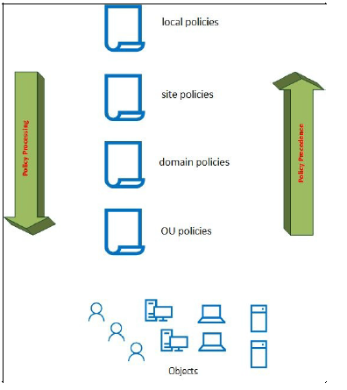
Policy Levels
In Active Directory environment, Group Policies are processed in this order.
Local Policies
Site Policies
Domain Policies
Organization Unit Policies
This order is called LSDOU
(pg 418).
Notes:
Francis, Dishan. “Group Policy Processing." Mastering Active Directory: Automate Tasks by Leveraging PowerShell for Active Directory Domain Services 2016. Birmingham: Packt Pub., 2017. 418.

Slide 7
Policy Levels
In LSDOU order, the first Policy to get processed is the Local Policy and the last one is Organizational Unit Policy.
This order is very important for when Policies hold conflicting values. In this situation the Policy which is closest to the object will dominate. For example, an organization might have one security policy for an entire infrastructure, but the users who have the most value to their accounts might have a stricter security policy. Therefore, Organizational Unit Policies hold the most accurate policy setting for the targeted objects.
This order is the default processing order, but based on the requirements of the infrastructure, we can change the precedence order if necessary.

Slide 8
Process Modes
Group Policies are mainly processed in two different modes, Foreground Processing and Background Processing.
By default, Group Policy’s computer settings will start to process during the startup process before the user log-on prompt. Once the user logs into the system, Group Policy’s user settings will start their process. This pre-processing mode is called foreground processing. During this process some policies will finish their processing, but some will not.
Policies that were started but not finished their processing during a foreground processing will continue their process after the user will log on into the system and establish a network connection. This is called Background processing.
Also, once the user is logged into the system, the group policies will refresh every 90 minutes by default to ensure everything is on the right track.

Slide 9
Foreground sub-modes
Foreground processing can be further divided into two sub-modes.
Synchronous mode
Policy settings must finish before the user sees the desktop after the login process.
Asynchronous mode
System does not wait until the Group Policy processes are finished, user is allowed to use the system while the Policies processes in the foreground.
There are four main policy settings that are defined by Microsoft that are always processed in the synchronous mode.
Any Policies that deal with software installation, disk quota, folder redirection and dive mapping will be processed in the synchronous mode. Not only that, all the startup scripts will also run in the foreground in synchronous mode.

Slide 10
Foreground sub-modes cont.
The default behavior of synchronous processing provides a faster logon time for users, but at the same time, some policy settings can take up to two log on cycles to apply the changes fully. This can have an impact on the systems security settings.
Therefore we have to examine carefully which processes have to run in synchronous and asynchronous modes prior of building the infrastructure.
Asynchronous mode is useful for when users are connecting to the network through a slow link, because elsewise it might take them an awful amount of time to get into the system.
If there is no specific reason, it is recommended by default that we use a synchronous mode when setting up the group policies and their execution.

Slide 11
Group Policy Inheritance
The order of inheritance between Group Policies, follows the LSDOU model. Group Policies applied in the upper level are inherited by the lower level.
Group Policy inheritance can be blocked at any level, in the situations where inherited policies are not related or needed.
In the example, We can see that local policies are on the top which means that site, domain and OU levels inherits from it. That follows for the rest of them, domain and OU inherits from site and so on.
(pg 418).
Notes:
Francis, Dishan. “Group Policy Processing." Mastering Active Directory: Automate Tasks by Leveraging PowerShell for Active Directory Domain Services 2016. Birmingham: Packt Pub., 2017. 418.

Slide 12
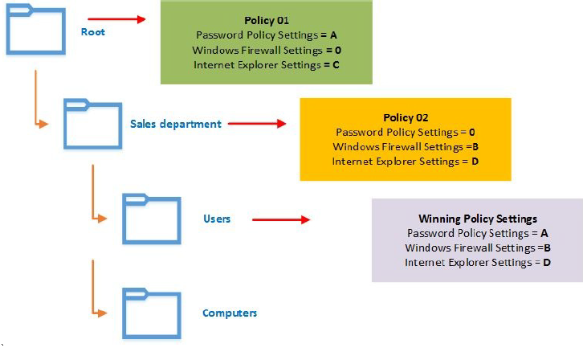
Group Policy Conflicts
With inheritance we might run into some Group Policy conflicts. These conflicts are resolved by LSDOU order and Group Policy inheritance.
In the example we can see that Root level defines Policy 01. Policy 01 is inherited by the rest of the structure. But if we look closely we can see that Policy 01 does not define Windows Firewall settings (0). On the other hand, Policy 02 has a definition for Windows Firewall Settings (B). In this situation, the Sales Depart- ment uses its own Policy for Windows Firewall Settings (B). Lastly, based on the LSDOU model the Users level will inherit Windows Firewall Settings Policy from Policy 02, unless Policy 03 has its own definition for the field.
(pg 424).
Notes:
Francis, Dishan. “Group Policy Conflicts”. Mastering Active Directory: Automate Tasks by Leveraging PowerShell for Active Directory Domain Services 2016. Birmingham: Packt Pub., 2017. 424.

Slide 13
Group Policy Conflicts cont.
This type of conflict handling is defaulted by Active Directory. Although it is a default behavior, we don’t have to follow it. Microsoft allows us to change this default policy winning procedure by enforcing policies.
When Group Policy has been enforced, it will have the lowest precedence value regardless of where its been linked.
Using enforced policies we can also bypass the blocking of inheritance. If we block the inheritance in our structure, but we enforce the policy at one of the upper levels, it will be present with the lowest precedence.
If multiple policies are enforced, all of them will take the lowest precedence numbers in order.

Slide 14
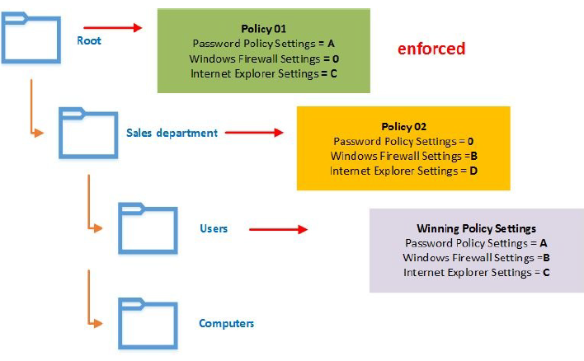
Group Policy Conflicts cont.
In the previous example we saw a default case of inheritance, now we are enforcing the top level policy on the lower levels.
Just as before, Root level is defined with under Policy 01, but this time we are forcing it thru ought the entire structure.
Therefor, any Policies that are defined within the root level will carry down the tree This behavior will take place as long as the Policy is defined, otherwise the default inheritance rules will follow as we can see with Windows Firewall Settings between Policy 02 and 03.
(pg 425).
Notes:
Francis, Dishan. “Group Policy Conflicts." Mastering Active Directory: Automate Tasks by Leveraging PowerShell for Active Directory Domain Services 2016. Birmingham: Packt Pub., 2017. 425.

Slide 15
References
Francis, Dishan. Mastering Active Directory: Automate Tasks by Leveraging PowerShell for Active Directory Domain Services 2016. Birmingham: Packt Pub. 2017.
Microsoft. "Group Policy API - Inheritance." Group Policy API (Windows). N.p., 17 July 2016. Web. 11 Apr. 2018. <https://msdn.microsoft.com/en-us/library/aa374155(v=vs.85).aspx>.

