Slide 1
Concepts of Computing Technologies Active Directory Components
Notes:
201820-CS99310 - ADV LEARN ASST SEMINAR COM SCI (Section 1) - Spring 2018
Brennan Ringel
Email: ringelb8@students.rowan.edu
Email2:brennanringel@gmail.com

Slide 2
Objectives
By the end of this lesson, you should be able to:
Understand what Active Directory Logical components are
Understand what a Forest is
Understand what a Domain is
Understand what a Domain Tree is
Understand what an Organizational Unit is
Understand what Active Directory Physical components are
Understand what a Domain Controller is
Understand what a Global Catalog Server is
Understand what an Active Directory Site is

Slide 3
Introduction to Active Directory Logical Components
Notes:
Replace this with your course title and your name/contact details.

Slide 4
Logical Components
Logical components are used to represent the organization hierarchical layout.
These allow us to manage our resources and security effectively.
Laying out the logical components of the Active directory helps to structure an identity infrastructure by considering design, administration, extensibility, security, and scalability.
Logical components consist of two types of objects
Container Objects - These can be associated with other logical objects.
Leaf Objects - These are the smallest components in a logical structure.
The four general organizing components are
An Organizational Unit
A Domain
A Domain Tree
A Forest
Notes:
Within an organization, there may be completely different groups. These groups

Slide 5





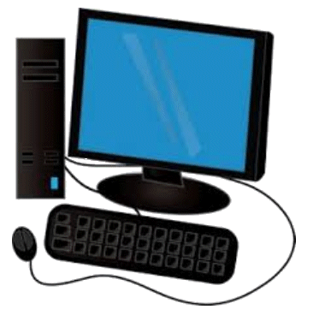

Domains
A domain contains all the logical components to achieve the administrative goals in an organization.
A domain, by default, is the security boundary to the objects inside it.
Active Directory domain
user
user
Key Term
security group
domain
a logical group of network objects (computers, users, devices) that share the same Active Directory database
mobile device
printer
workstation
laptop

Slide 6
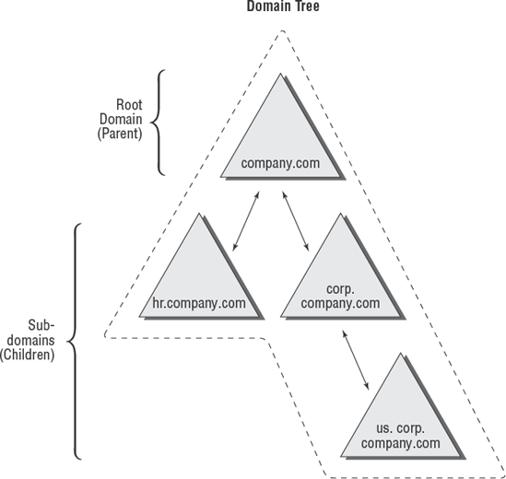
Domain Trees
Key Term
domain tree
a collection of domains that reflects the organization’s structure
The first domain in a domain tree is called the parent domain or root domain of that tree.
All other domains in the tree are considered child domains.
Child domains must have a contiguous namespace, as seen in this image
Notes:
In the example here, rebeladmin.com is the parent domain for the domain tree. It has two child domains, it.rebeladmin.com and sales.rebeladmin.com. As you can see, it shares the same rebeladmin.com namespace. Similarly, when it goes down in the next level in the domain tree, it shares the namespace from the preceding level

Slide 7
Domain Trees (Continued)
All domain trusts within the Active Directory forest are two-way transitive trusts.
Two-way trust means the authentication requests can be processed between two domains in both ways.
Transitive means it goes beyond the initial two-way trust between domains and trusts its child domains too even though there is no direct connection.

Slide 8
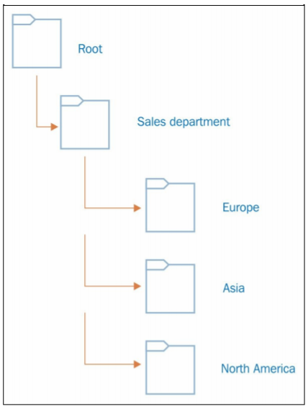
Organizational Units (OUs)
These are groups for administrative purposes
Logically, it makes sense to separate different departments and regions into different OUs.
Security policies applied to the OU level cascade down to the user level.
This allows us to deal with many users who should have similar permissions quickly.
Splitting into regions can help us deal with similar departments across different regions.
Key Term
OUs can contain objects such as users, groups, contacts, computers, printers, and even other OUs.
By default, all OUs inherit the permissions applied to the parent OU.
OUs can only contain objects from the same domain.
The administrator can add, remove, and delete OUs as required.
OU (organizational unit)
container object within an Active Directory into which you can place users, groups, computers, and other organizational units to mirror your organization's functional or business structure.
Notes:
(For the fourth bullet) At Rowan, Computer Science students have access to a computer lab room. In the room is a printer that is free for Computer Science students to use. Sometimes, non-computer science students are caught printing things like math textbooks. If upper management decided that CS students could not be trusted with their free printing anymore, the right to printing could be taken away from the Computer Science OU, rather than taken away from one user at a time. If time passes and the department wants to trust the students again, they can simply give permissions back to the OU, rather than to individual students.
(for the fifth bullet) People in sales departments in different regions may have access to different printers, and other resources. This also allows domain administrators to delegate control over those objects in that region to individuals or groups in the region’s regional office without giving these individuals too much power. For these administrators (the individuals mentioned earlier), they would not be able to modify any objects outside of the OU that they are assigned to.

Slide 9
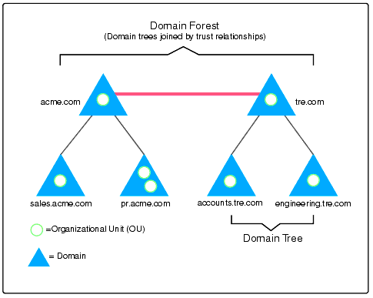
Forests
Forests consist of Domains and Domain Trees.
Domains and domain trees inside of a forest have two-way transitive trust.
Domains in a forest can contain any domain name.
Domain controllers within a forest must be running a minimum version of Active Directory of whatever the forest is running.
forest
collection of domain containers that trust each other
Key Term
acme.com trusts tre.com
sales.acme.com trusts engineering.tre.com
Notes:
For example, if the forest function level is Windows Server 2008, it is allowed to install the domain controller inside the forest with the operating system Windows Server 2016. But this doesn't mean it can use features provided by Windows Directory Services 2016 until it upgrades its domain and forest functional levels. If you upgrade the forest function level to Windows Server 2016, you can have only domain controllers running a minimum of Windows Server 2016.

Slide 10
Introduction to Active Directory: Physical Components
Notes:
Replace this with your course title and your name/contact details.

Slide 11
Physical Components
The physical components are Independent of the Logical Components.
Physical component placement can affect Active Directory replications in certain ways.
Logically, components can be easily rearranged compared to physical components.

Slide 12
Domain controller
The domain controller is a computer that runs a Windows Server operating system and holds the Active Directory Domain Services (AD DS) role.
Domain controllers can be a physical server, or a virtual one.
The number of domain controllers is dependent on the enterprise's size, geographical placement, and network segmentation.
domain controller
A server running Active Directory Domain Services (AD DS) is called a domain controller. It authenticates and authorizes all users and computers in a Windows domain type network — assigning and enforcing security policies for all computers and installing or updating software.
Key Term

Slide 13
Global Catalog Server
The Global catalog server holds the full writable copy of objects in its host domain and the partial copy of objects in other domains in the same forest.
The partial replica contains a copy of every object in the forest, and the most commonly used attributes used by queries.
Applications and users in one domain can query for the objects in another domain (same forest) via the global catalog server.
When installing the first domain controller, it will become the Global Catalog Server.
Other domain controllers can be promoted to Global Catalog Servers as needed.
Notes:
Not all domain controllers in the domain need to be a global catalog server.

Slide 14

Active Directory Sites
Since they are in the same domain and forest, DC01 to DC04 should replicate changes to each other in order to maintain a healthy identity infrastructure.
The AD DS site structure defines a physical topology of the network.
Sites can be separate buildings in a campus network and branch office in a separate city or even in a separate country.
Logically, the branch office in Canada is in the same Active Directory forest and domain as the London office.
The two offices can be called two sites.
192.168.148.0/24 10.10.10.10.0/24 172.25.16.0/24
London Office
DC01
DC02
DC03
DC04
10.11.11.0/24 172.0.2.0/24
Toronto Office
Notes:
In our example here (visual), Rebeladmin Corp. has its head office located in London office, UK. It is running a few domain controllers (DC01 and DC02) within its physical network. It uses IP address allocation for the network with subnets 192.168.148.0/24, 10.10.10.0/24 and 172.25.16.0/24. Due to the business requirements, the company opened a branch office in Toronto, Canada.

Slide 15
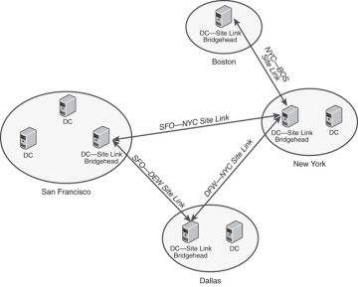
Active Directory Sites
To enable replication, AD DS logically organizes groups of servers into a concept known as sites.
A single site should be composed of servers that are connected to each other via high-speed connections.
The links that connect two or more locations (potentially through slower-speed connections) are known as site links.
Site 2: Boston
High speed connection
Site 1: San Fran
site link
site link
site link
site link bridgehead
Notes:
Sites are created with site links connecting the locations together to enable the administrator to specify the bandwidth used to replicate information between sites. Instead of having information replicated immediately between servers within a high-speed connected site, the administrator can specify to replicate information between two sites only once per night or at a time when network demands are low, allowing more bandwidth availability to replicate AD DS information. Site links exist between offices, and a DC in each site acts as the site link bridgehead

Slide 16
Benefits of Active Directory Sites
Using AD DS sites, it's possible to perform bandwidth optimization and replication schedule changes for reliable replication across domain controllers.
Using sites and the subnet setup, we can point users to the nearest server for the services.
AD DS sites will allow you to ensure that users in the Toronto site will use the nearest domain controller for authentication (rather than authenticate with London). This will reduce latency and bandwidth through the site links.

Slide 17
References
Francis, Dishan. Mastering Active Directory: Automate Tasks by Leveraging PowerShell for Active Directory Domain Services 2016. Packt Pub., 2017.
Lingala, Thirupathi, and Afreen Sana Begum. “Active Directory and Related Aspects of Security.” Academicscience.co.in, Methodist College of Engineering and Technology, Hyderabad Telangana, INDIA, Mar. 2018, academicscience.co.in/admin/resources/project/paper/f201803281522224187.pdf.

