Slide 1
Concepts of Computing Technologies Certificates and Certificate Authorities
Notes:
Advanced Learning Assistant Seminar, Spring 2018, Patrick Richeal, richealp7@students.rowan.edu

Slide 2
Objectives
By the end of this lesson, you should be able to:
Know what a Certificate is and what it contains
Know how to obtain a Certificate
Know what a Certificate Authority is
Know the different types of Certificate Authorities
How Certificates work in Active Directory
Certificate Authority Hierarchy
How to obtain Certificates
Types of Certificate authorities
Certificate options
Architecture of Certificate Authorities

Slide 3
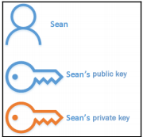
Public and Private Keys
Asymmetric encryption uses two types of keys
Public Key- A key that is given to the recipient of the data so that they may decrypt the data. It is known as a public because this key is out in the world and is more vulnerable. A public key can Decrypt any message Encrypted by the Private key and any message encrypted by the Public key can be decrypted by the Private Key.
Private Key- A key that is kept with the user and is not given publicly, This key is NOT out in the world and is therefore safer. Any message Encrypted by the Private key can only be decrypted by the Public Key, and any message encrypted by the public key can be decrypted by the private key.

Slide 4
Terms
Signing Algorithm- an algorithm used to hash a message
Key Term
signing algorithm
an algorithm used to has a message.
Key Term
hash (v)
generate a number from a string of text. The hash value is substantially smaller than the text itself, and is generated by a formula in such a way that it is extremely unlikely that some other text will produce the same hash value.

Slide 5

Certificates and Certificate Authorities (CA)
Public and private keys are used to encrypt, but that isn't all we need.
Who do we get these public and private keys from. How do we know if a public key is legitimate? How do we know when expires or is compromised?
The answer is Certificates and Certificate Authorities.

Slide 6
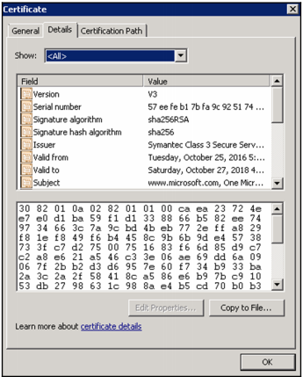
Certificate
A Certificate is kind of like a passport issued to users, computers, services and Network devices.
Form of legitimate identification for a public/private key that can be verified with a known and trusted authority.
They contain the following information:
Version of certificate (current version is x.509)
It’s serial number (unique Identifier)
A Signature Algorithm
Issuer
Valid From date
Valid To Date
Subject: who the Certificate was issued to
Public Key
Public Key

Slide 7
Certificate Con’t
We can derive from Certificate contents, some important pieces of information:
Time limit: certificates have a time limit, they have a starting date and an ending date and any certificate that has past it’s date is no longer valid and must be renewed.
An Issuer: Someone can be contacted to verify the certificate
Subject: we know who this certificate is supposed to be for.
Serial number: each certificate is unique so that we know how to track it.

Slide 8

Certificate in Signing and Encryption
During signing process the certificate is used to retrieve the sender's private key and attach it’s public key to the sent information. As well as using the private key from the certificate for encryption.
During the decryption processes the recipient would have a certificate issued to them that contains the sender's public key and then they could compare the sent public key with their own to verify it’s data.
It is also good practice to check with the Certificate Authority to assure that the Certificate is still valid.

Slide 9

Certificate Uses
What else can Certificates be used for?
They can be used to Encrypt traffic between two peers in a Virtual Private Network
The can be used to Encrypt Files in the Encrypted File System
They can be used to Connect to Wireless Networks
Verification of Identity
Secure Communication
Used to Digitally Sign emails
Verify Installation Files
Prove Site Validity
Non-repudiation i.e., Since CA’s are trusted data signed with a Certificate from a trusted CA CANNOT be refused as the legitimate owner is established

Slide 10

Certificate Authority
As we mentioned before about an issuer, someone is responsible for issuing certificates and and keeping track of their validity. They become something we can check with to assure that a certificate is valid, just like another country can check with your government to see if a passport is valid. They can:
Issue Certificates
Store Certificates
Manage Certificates
Revoke Certificates

Slide 11
Private vs. Public CA
A Private Certificate Authority is what you can set up in Activity Directory as an internal solution to certificate validation, however someone outside of the infustruction would have to explicitly trust your certifications.
A Public Certificate Authority is an entity that is trusted outside of your organization, most computers come with some pre-trusted public CAs. They have a higher security and are highly trusted, however to use these services you must pay for them, which can get expensive for a big company. Available to anyone.
Some examples are Comodo, Symantic, and GoDaddy

Slide 12
Certificates in Active Directory
In Active Directory Certificates are issued by Issuing Certificate Authorities to Users ,Devices, Services and Network Devices. They are trusted automatically internally but can be trusted externally as well.
Certificates obtained by the user is stored in the Certificate store
Certificates obtained by computers are also stored in the Certificate Store
Services are not given Certificates Directly, but instead users or computers are given certificates associated with them.
Certificate templates should be changed to suite the object type

Slide 13
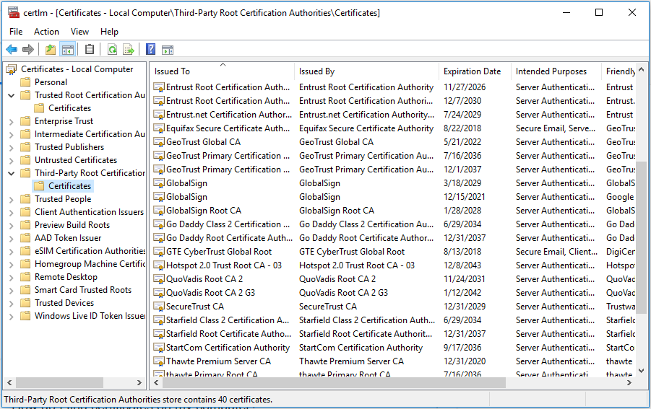
Certificate Template
Certificates start with a default template, but if you want improved security you can can some attributes about them.
What can be changed about the Certificate Template?
Cryptography Key Length
Longer is better though takes more time to generate, encrypt, and decrypt.
Hashing Algorithms
By default it is SHA256
Validity Period
Up To Admin, through recommend short for user and longer for computer
Cannot be changed once Issued

Slide 14
Certificate Acquisition
A user can obtain Certificates in many ways, Certificate Authorities can issue Certificates through:
Certificate Enrollment Web Services:
Certificates Authorities obtain Certificates through web browser
Certificates can be obtained outside the Corporate Network
Can Take Template based Requests
Auto Enrollment can be used for in-Domain Devices
Certificate Enrollment Policy Web Service:
Like Certificate Enrollment Web Services but specifically for non domain computers.
Certificate Authority Web Enrollment:
Similar to the CEWS however Acquisition is through an interface
Can be used to obtain higher CA certificates

Slide 15
SCEP
SCEP
Simple Certificate Enrollment Protocol- a simple protocol used to issue certificate to network devices. SCEP is the most popular, widely available, and tested certificate enrollment protocol. The protocol is designed to make the issuing of digital certificates as scalable as possible.
Key Term

Slide 16
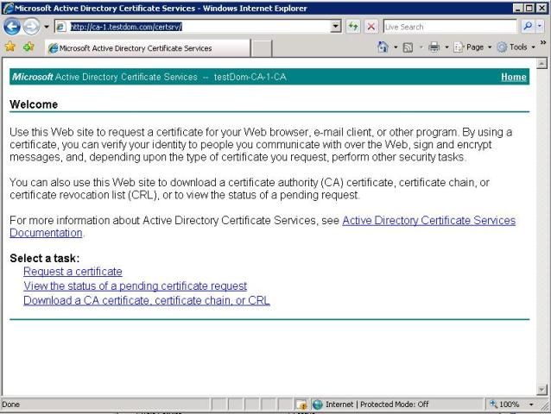
Certificate Acquisition Con’t
Network Device Enrollment Services
Using the SCEP it allows network device to have Certificates issued to them
Certificates for Network device help secure traffic
Online Responder
A utility used to verify the status of certificates, it checks to see if a Certificate is out of data, revoked or legitimate.

Slide 17
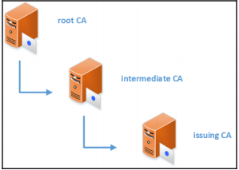
CA Hierarchy
There are Two types of Certificate Authorities:
The Root Certificate Authority
Most trusted
Issues and Renews Certificates to Certificate Authorities
Needs to be the most secure
Should only issue Certificates to Certificate Authorities
Only One Root CA
has a longer validity period
Can have Subordinate CAs
Francis, D. (n.d.). Mastering Active Directory pg.558.

Slide 18
CA Hierarchy
The Subordinate Certificate Authority
Issues Certificates to Objects or Services, known as Issuing CA
Can be Multiple Subordinate CAs
Has Certificate from root CA giving it Validity, though it can expire it does have a longer validity period
Can have Subordinate CAs, if it does have subordinate CAs it is known as an Intermediate CA
SSL security built upon a Chain of Trust emanating downwards from the Certificate Authority (CA), Lacking a CA's root certificate, no browser would know whether to accept an SSL certificate issued by that CA.
CAs are bound to respect very strict security guidelines to ensure their certificates do not get compromised. That is why each CA's root certificate is jealously guarded, and is not used to sign end users' certificates directly.
Rather, all CA's make use of intermediate certificates that have been signed by the root certificate, and those in turn are used to validate end users' certificates.

Slide 19
Enterprise vs. Standalone CAs
Standalone CA
Includes root CAs
Issues to subordinate CAs
Stays OFFLINE
Manual Certification Issuing and acceptance
These CAs are used to issue to other CAs and tend to be offline for security reasons, helps the CA structure function
Enterprise CA
Requires less manpower
Cannot be offline
Auto enrollment
Auto Approval
These CAs are used to issue certificates to objects and services, They help the business function

Slide 20
Certificate Architecture
When building a Certificate Architecture, there are a few things to consider:
Availability
You want a high availability so that issuing and verifying Certificates can run smoothly
Certificate Templates
Choose Certificate Templates That Are right for your company and right for your objects, i.e., certificates for employees have a shorter validity date when compared to devices
Boundary
How far does the CA reach
Should this CA operate outside of its domain or tree?
Under which domain, forest, or network segment will it operate?
Once the boundaries are defined, it can be hard to extend it later without any physical or logical network layer changes.
As an example, if a partner company or third party wants to use the corporate CA, it will require the AD CS role changes, firewall changes, network routing changes, DNS changes, and so on. Therefore, it's important to evaluate these types of operation requirements in the planning process.

Slide 21
CA Models
There are many ways to structure a CA, ranging from simple to complex, from cheap to expensive, CAs should be structured to fit the company. The following are a few standard models for a CA.
One Tier Model
Two Tier Model
Three Tier Model

Slide 22
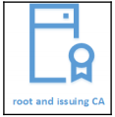
Certificate Authority Models
Single Tier - A single CA that acts as both the root and Issuing CA
Pros
Simple
Cheaper
Easy to deploy and manage
Cons
Not recommended for production networks
Vulnerable
Root CA is Issuing CA
Not scalable
High Workload

Slide 23
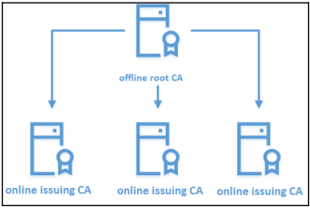
Certificate Authority Models
Two Tier Model - A root CA with Issuing CAs
Pros
Most Commonly Used
Root CA is offline and safer
Compromise of Expense and Management
Root CA issues to Issuing CAs
Issuing CAs Issue Certifications to objects
Root CA does not need to be a domain Member
Is Scalable
Higher Security
Improved Performance
Flexible Maintenance
Cons
Renewing Issuing Certificates is a manual process
Higher Maintenance

Slide 24
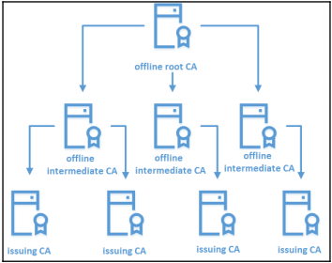
Certificate Authority Models
Three Tier Model - A root CA with Intermediate and Issuing CAs
Higher Cryptography Potential
Root and Intermediate CAs are standalone CAs
Root issues to intermediate and intermediate issue to issuing
Pros
Improved security
High performance
Good boundaries
Improved control
High availability
Cons
High cost
High maintenance
complex

Slide 25
References
EMC Education Services. 2012. Information storage and management: storing, managing, and protecting digital information 2nd ed., Hoboken, NJ: Wiley.
Internet X.509 Public Key Infrastructure Certificate and Certificate Revocation List (CRL) Profile. (n.d.). Retrieved April 10, 2018, from https://tools.ietf.org/html/rfc5280#section-4.1.1.2

