Slide 1
Concepts of Computing Technologies Devices and AD Best Practices
Notes:
201820-CS99310 - ADV LEARN ASST SEMINAR COM SCI (Section 1) - Spring 2018
Brennan Ringel
Email: ringelb8@students.rowan.edu
Email2:brennanringel@gmail.com

Slide 2
Objectives
By the end of this lesson, you should be able to:
What is classified as an object in Active Directory.
Have a basic understanding of how objects are handled in Active Directory.

Slide 3
Devices
Active directory supports many other devise and object types as well. Including, Tablets, Work Stations, Wireless devices, printers and many more.
In this lesson we will focus mostly on the Printers, since they are most commonly shared resource in an office network.
Printers can be configured several ways in active directory:
Printer setup wizard => Connection via IP Address.
Log on scripts => Map and install printers in workstations.
Printer servers => Connect and install a printer on the server.
Printer Object = > Register printer as an object in Active Directory.
Registering the printer as an object in Active Directory will allow the users to browse the Active Directory and find the relevant printer quickly, without going through different printer servers.

Slide 4
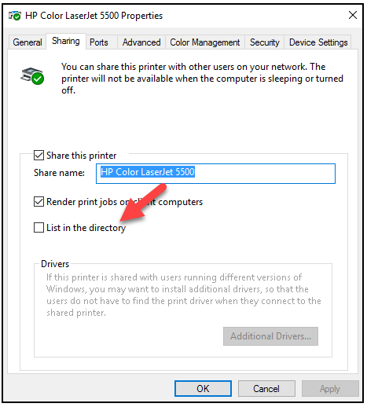
Devices : Printers
Printers can be integrated with a directory from the printer properties.
To register a printer, we need to go to Printer properties and then to the Sharing tab, there we will need to check the ‘List in the directory’ checkbox to list the printer in on Active Directory.
(pg 371).
Notes:
Francis, Dishan. “Devices and Other Objects Mastering Active Directory: Automate Tasks by Leveraging PowerShell for Active Directory Domain Services 2016. Birmingham: Packt Pub., 2017. 371.

Slide 5
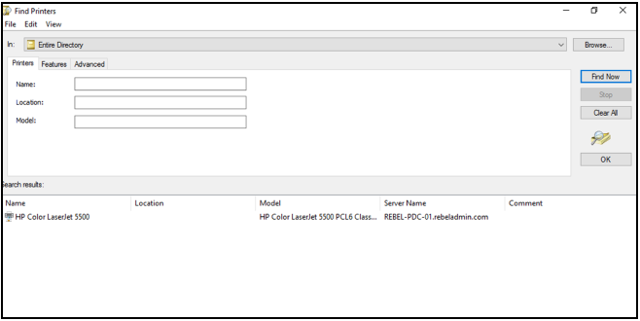
Devices : Printers
Then in the workstation we will need to select the option to list printers from the directory during the printer setup process, and that will list all the printers available for that directory in a window:
(pg 371).
Notes:
Francis, Dishan. “Devices and Other Objects Mastering Active Directory: Automate Tasks by Leveraging PowerShell for Active Directory Domain Services 2016. Birmingham: Packt Pub., 2017. 371.

Slide 6
Other Objects : inetOrgPerson
inetOrgPerson is an object used by other directory services which are based on LDAP and X.500 protocols.
Main purpose of the inetOrgPerson is to support migration from non-Microsoft directory service and support applications that requires inetOrgPerson objects.
In Active Directory we are able to convert inetOrgPerson objects to a user object and the other way around. The ability of being able to convert inetOrgPerson to a user object, makes the process of exporting and importing users with Active Directory much easier.

Slide 7
Other Objects : inetOrgPerson
To create a inetOrgPerson object we need to follow these steps :
Open the Active Directory users and Computers snap-in
Make sure that the domain is correct, if not select ‘Connect to domain’, there we will enter the right domains name and click ‘OK’.
Then we will right-click the user container and select New => inetOrgPerson.
Then we will fill out appropriate fields such as first name, last name, etc.
Then we will set up the password, and any flags relating to it.
Click Finish, and at this point we have a new inetOrgPerson object.

Slide 8
Best Practices
Managing Active Directory objects is an important task of administrator, with that comes a great amount of responsibility. There are a few practices to keep this task at a good condition. Some of the well known practices are :
Housekeeping
Adding description
Protecting objects from accidental deletion
Object naming conversion
**cited
Notes:
Francis, Dishan. “Managing Groups, Objects and Devices – Best Practices Mastering Active Directory: Automate Tasks by Leveraging PowerShell for Active Directory Domain Services 2016. Birmingham: Packt Pub., 2017. 373.

Slide 9
Practices : Housekeeping
Housekeeping is one of the most important tasks to keep your Active directory up to date.
It is important to review the validity of Active directory objects from time to time. In some cases there can be objects which are no longer active in operations. Those objects can be, computers, groups, or user projects and devices. Few ways of handle these type of objects are :
If it is possible to verify that an object is completely not in use, we can delete it from Active Directory.
If it is not possible to confirm, then we have an option of disabling it or monitor it for events. If there are no events, then we are clear to delete it.
**cited
Notes:
Francis, Dishan. “Managing Groups, Objects and Devices – Best Practices Mastering Active Directory: Automate Tasks by Leveraging PowerShell for Active Directory Domain Services 2016. Birmingham: Packt Pub., 2017. 374.

Slide 10
Practices : Housekeeping cont;
A good practice to manage disable objects is to create a different Organizational Unit and move the disabled objects there.
This will allow the Administrator to keep the track of them and it will also provide an easy access to them when needed.
Another case is when objects are used for a limited time. A good example for this is the accounts which are used only during some project.
In this case we can keep the disabled accounts and only enable them when they are required.
Past employee accounts also fall into this category.
**cited
Notes:
Francis, Dishan. “Managing Groups, Objects and Devices – Best Practices Mastering Active Directory: Automate Tasks by Leveraging PowerShell for Active Directory Domain Services 2016. Birmingham: Packt Pub., 2017. 374.

Slide 11
More Practices
Adding description is a very good practice due to the fact that you might not always be the person who is managing the OU.
One should always add a description to the objects, if it cannot be described by its given name. We can relate this to code documentation, as it allows a better readability which makes locating and understanding the object relatively quickly
Protecting objects from accidental deletion is also a critical practice, this speaks for it self. This feature can be enabled on user, computer and group objects.
It can be enabled on individual object or the Organizational Unit as well as directory level.
To delete an object on purpose, we are going need to disable this feature.
Object naming conversion is used mostly in organizational level. Always follow the standards when defining names, usernames for the objects.
These standards can be different from business to business, so it is recommended to document these standards. Well commented and documented Infrastructure of Active Directory saves a lot of time of resources.
Notes:
Francis, Dishan. “Managing Groups, Objects and Devices – Best Practices Mastering Active Directory: Automate Tasks by Leveraging PowerShell for Active Directory Domain Services 2016. Birmingham: Packt Pub., 2017. 374.

Slide 12
References
Francis, Dishan. Mastering Active Directory: Automate Tasks by Leveraging PowerShell for Active Directory Domain Services 2016. Birmingham: Packt Pub. 2017.

