Slide 1
Concepts of Computing Technologies DNS Records
Notes:
201820-CS99310 - ADV LEARN ASST SEMINAR COM SCI (Section 1) - Spring 2018
Brennan Ringel
Email: ringelb8@students.rowan.edu
Email2:brennanringel@gmail.com

Slide 2
Objectives
By the end of this lesson, you should be able to:
Understand what the main DNS records are and what their purposes are
Notes:
By the end of this lesson, you should be able to understand what the main DNS records are and what their purposes are.

Slide 3
DNS Records
The DNS database that lives on a DNS server holds various different types of resource records that provide different information about a domain
In an active directory environment, these records are often created automatically when adding resources to the domain, changing settings in the domain, or install/removing domain controllers
These resources can all be changed manually
Other resources have to be added to the DNS server based on infrastructure requirements
Notes:
The DNS database that lives on a DNS server holds various different types of resource records that provide different information about a domain. In an active directory environment, these records are often created automatically when adding resources to the domain, changing settings in the domain, or install/removing domain controllers, but these resources can all be changed manually. Other resources have to be added to the DNS server based on infrastructure requirements.

Slide 4
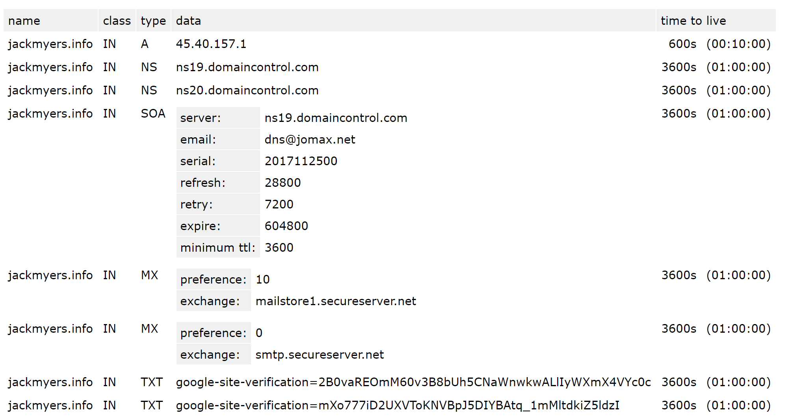
Sample DNS record

Slide 5
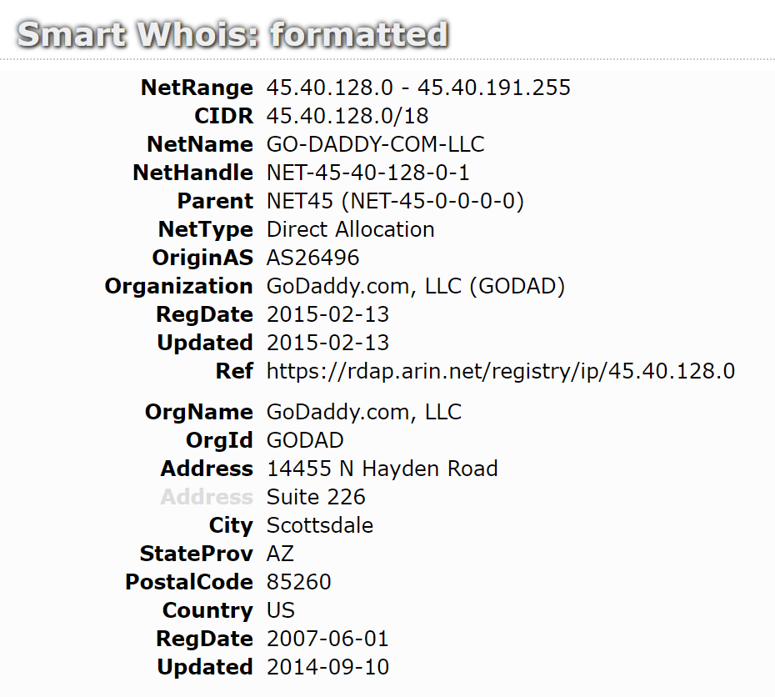
A and AAAA records
The A and AAAA records are referred to as the host record
An A record maps a domain name to the IP address (IPv4) of the computer hosting the domain.
The host record is the main record that links the domain name to a physical IP address
This is what allows domain names to eventually be resolved to external servers that return data, like a server hosting a website
When a DNS query comes into a DNS server looking to resolve a domain name to an IP address, this is the resource that will eventually be accessed
The A record is used for IPv4 address while the AAAA record is used for IPv6 addresses
Notes:
The A and AAAA records and referred to as the host record. The host record is the main record that links the domain name to a physical IP address. This is what allows domain names to eventually be resolved to external servers that return data, like a server hosting a website. When a DNS query comes into a DNS server looking to resolve a domain name to an IP address, this is the resource that will eventually be accessed. The A record is used for IPv4 address while the AAAA record is used for IPv6 addresses.

Slide 6
Host Record Example
The A or AAAA records of any domain name that is public to the internet are available for anyone to read and observe
Following that logic, the domain google.com should have a public A record that points to a specific IP address (a server at Google)
By performing a DNS lookup, the A record of google.com has the IP address of 172.217.10.78
The A record that returns that specific IP address is what allows the google.com domain to function the way it is intended, to connect you to some server at google.com
When active directory is integrated with DNS, every device will have either a A or AAAA record when it is added to the domain
If the IP address of the device gets changed, the active directory infrastructure will automatically update it’s A or AAAA record to match the new IP address
Notes:
The A or AAAA records of any domain name that is public to the internet are available for anyone to read and observe. Following that logic, the domain google.com should have a public A record that points to a specific IP address, which would be a web server at Google. By performing a DNS lookup, the A record of google.com has the IP address of 172.217.10.78. The A record that returns that specific IP address is what allows the google.com domain to function the way it is intended, to connect you to some server at google.com.

Slide 7
MX Records
MX record stands for mail exchange record
MX records specify the mail exchange server for the domain
MX records must point to a domain name, not an IP address
A domain can have multiple MX records, each with a mail server priority number
The mail server priority number specifies which servers to attempt to use first
The lowest number will get the highest priority
Godaddy-hosted email (if you choose to host your email through godaddy) is hosted under the "secureserver.net" domain..
Notes:
MX record stands for mail exchange record. MX records specify the mail exchange server for the domain, and most point to a domain name, not an IP address. A domain can have multiple MX records, each with a mail server priority number. The mail server priority number specifies which servers to attempt to use first. The lowest number will get the highest priority.

Slide 8
Canonical Name Records
Canonical name records, or CNAME records, allows you to point one domain or subdomain to another domain name
They simply redirect the request to the domain specified on the CNAME record
CNAME records allow you to direct many domains or subdomains to one specific domain that points to a specific IP address
This means you can have every domain always point to that IP address, and you can change that address by only updating one A record (host record)
Notes:
Canonical name records, or CNAME records, allows you to point one domain or subdomain to another domain name. They simply redirect the request to the domain specified on the CNAME record. CNAME records allow you to direct many domains or subdomains to one specific domain that points to a specific IP address. This means you can have every domain always point to that IP address, and you can change that address by only updating one host record.

Slide 9
CNAME Example
Lets say that Google wants to change a domain from maps.google.com to map.google.com
They first would create a new A record for map.google.com that points to the correct IP address and remove the A record from maps.google.com
But now what happens when old users use the old domain?
Google can setup a CNAME record to point maps.google.com to map.google.com, so the old users still get directed to the domain that points to the correct IP address
Notes:
Lets say that Google wants to change a domain from maps.google.com to map.google.com. They first would create a new A record for map.google.com that points to the correct IP address and remove the A record from maps.google.com. But now what happens when old users use the old domain? Google can setup a CNAME record to point maps.google.com to map.google.com, so the old users still get directed to the domain that points to the correct IP address.

Slide 10
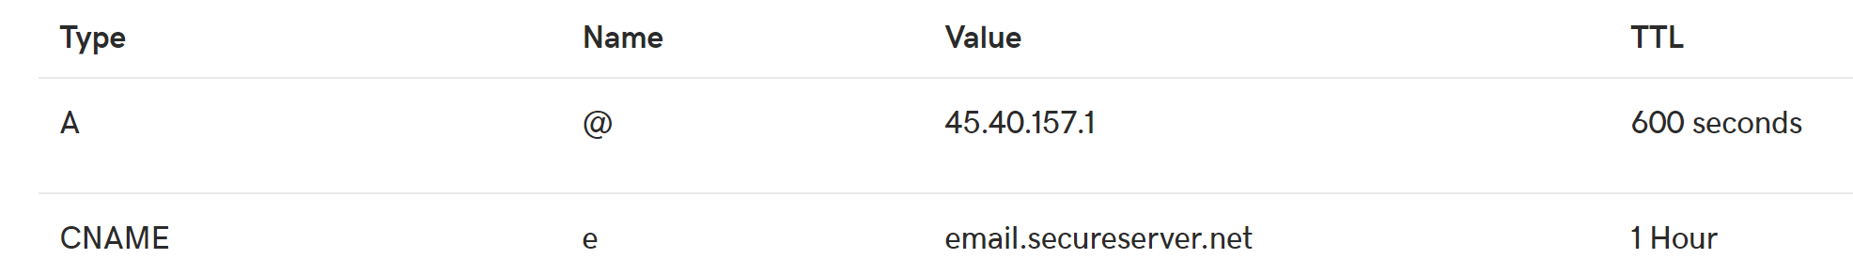
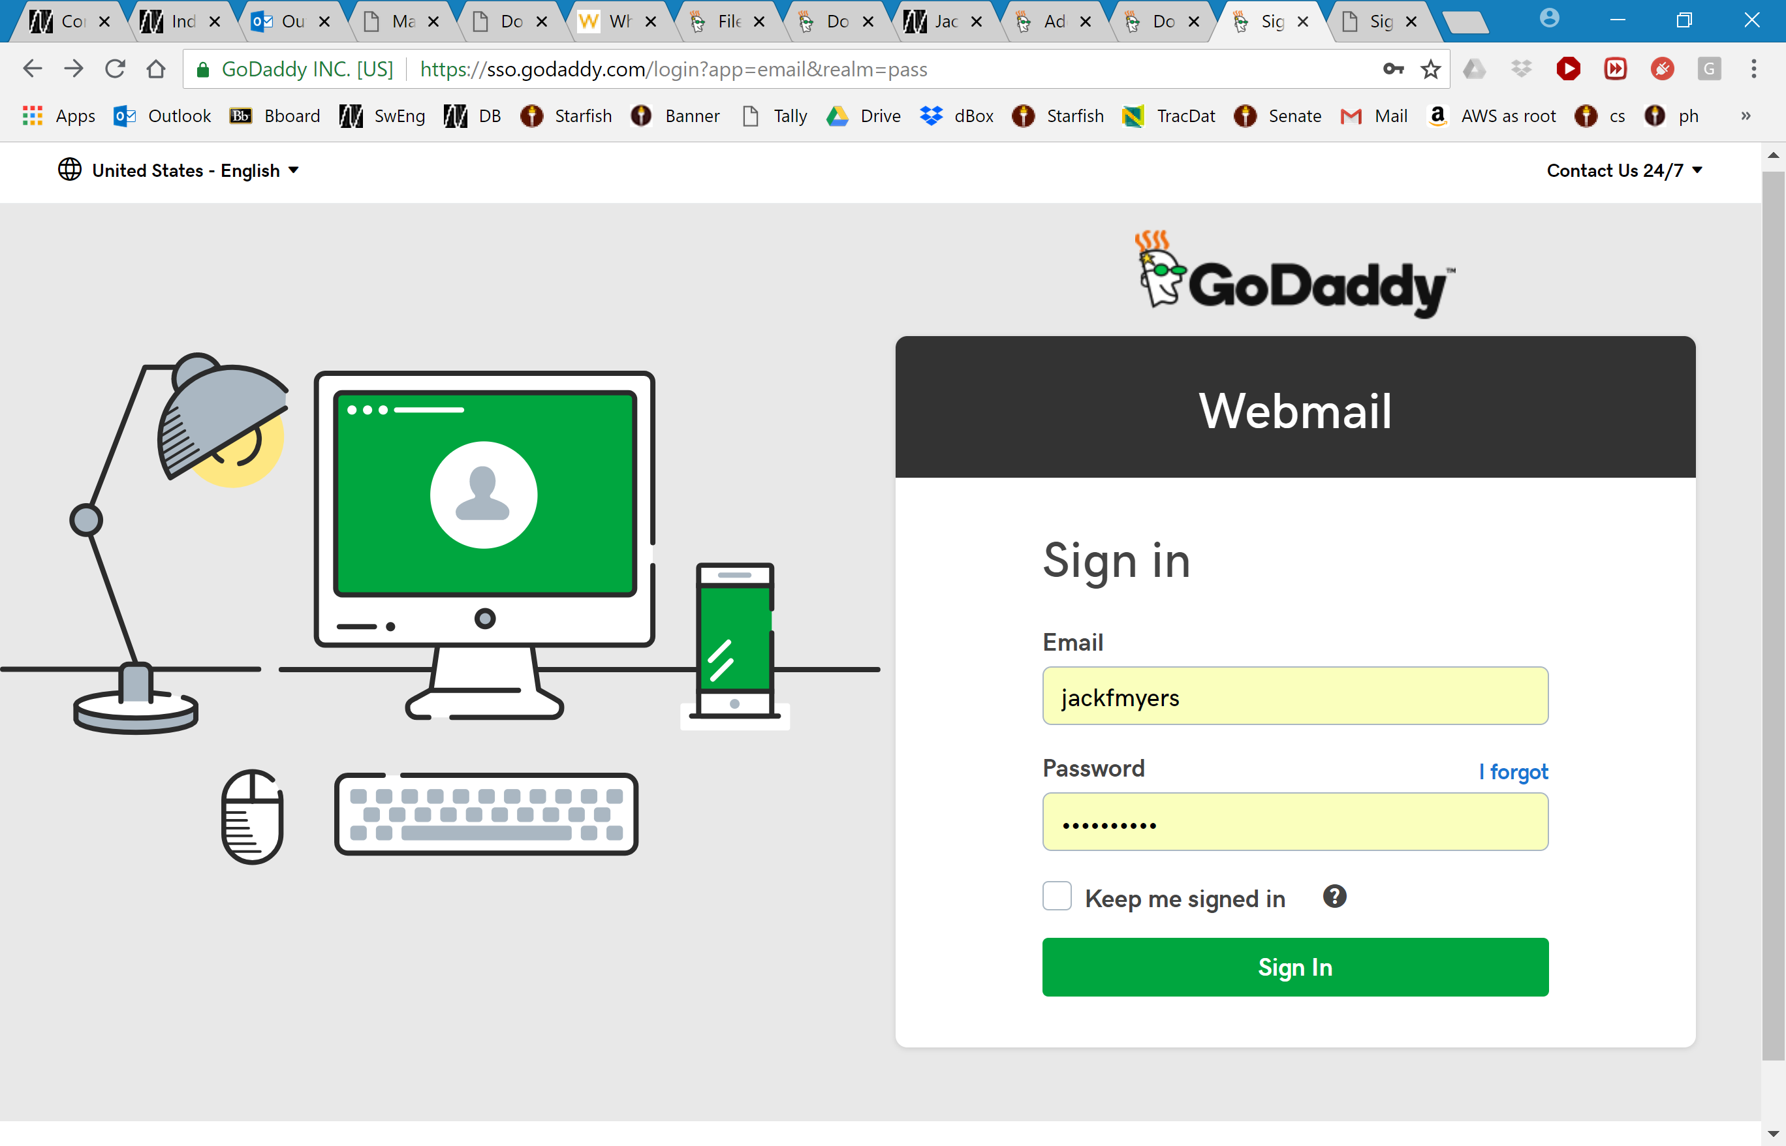
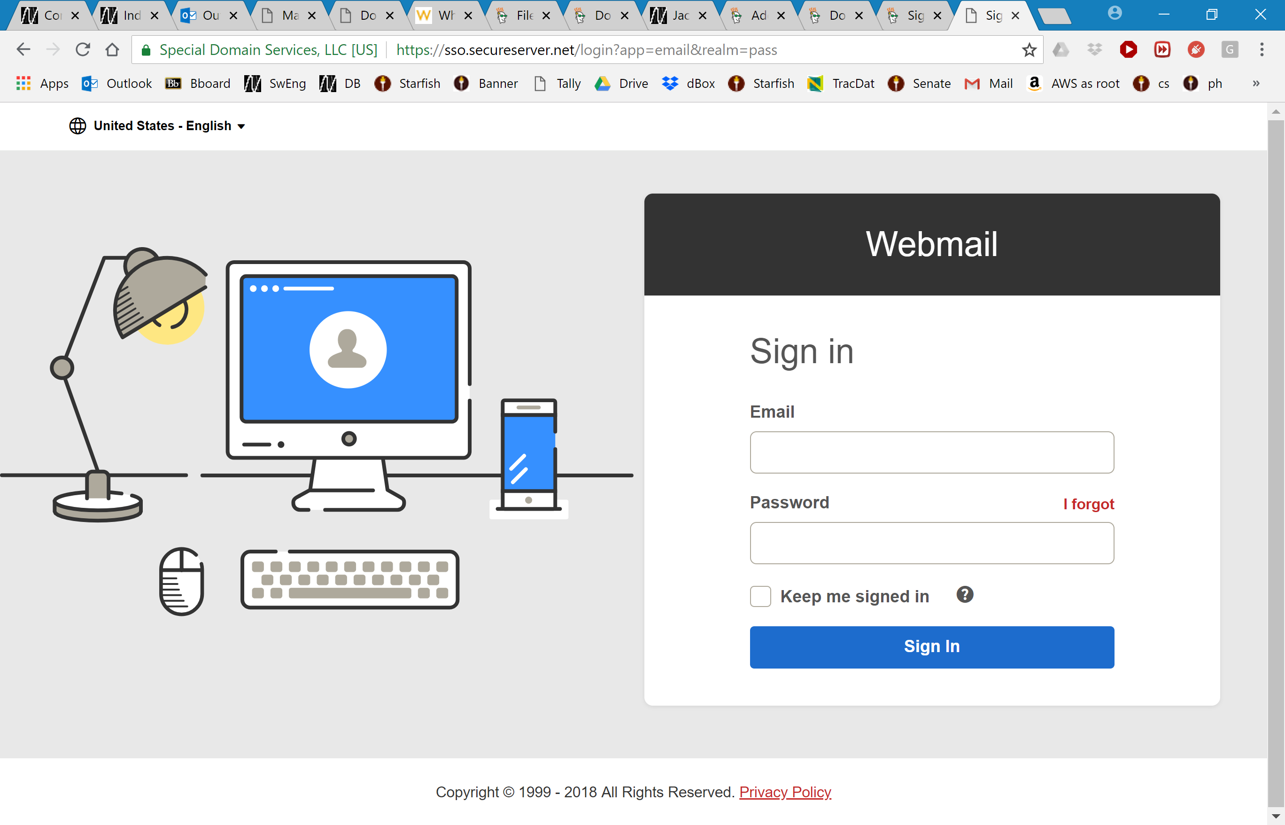
Another CNAME example
Here is some information from domain jackmyers.info
Typing in e.jackmyers.info sends me to https://sso.godaddy.com/login?app=email&realm=pass
Typing in email.secureserver.net sends me to https://sso.secureserver.net/login?app=email&realm=pass

Slide 11
PTR Records
PTR record stands for pointer resource record and are used to map IP addresses to domain names
They can be thought of doing the opposite of what the A record does and are sometimes referred to as reverse DNS records
Each PTR record should have a corresponding A record
They are used so it is possible to perform a reverse DNS lookup and find the domain names that point to a specific IP address
Notes:
PTR record stands for pointer resource record and are used to map IP addresses to domain names. They can be thought of doing the opposite of what the A record does and are sometimes referred to as reverse DNS records. Each PTR record should have a corresponding A record. They are used so it is possible to perform a reverse DNS lookup and find the domain names that point to a specific IP address.

Slide 12
SRV Records
SRV records, or service records, are used to specify the location of a service inside an infrastructure
For example, if you have a web server in an infrastructure, you can specify the protocol, service, domain name, and define the service location using an SRV record
In an AD environment, SRV records are particularly important as they are used to locate the domain controllers in the infrastructure
The following information can be specified in an SRV record
Service: This will define the service this SRV record is assigned to
Protocol: This will define the protocol it will use (TCP or UDP)
Priority: This will define the service priority (if the service supports that functionality)
Weight: This will define the order it should serve along with the similar type of records
Port number: This will define the service port number
Host offering this service: This will define the server offering this particular service (the domain name of the server)
Notes:
SRV records, or service records, are used to specify the location of a service inside an infrastructure. For example, if you have a web server in an infrastructure, you can specify the protocol, service, domain name, and define the service location using an SRV record. In an Active Directory environment, SRV records are particularly important as they are used to locate the domain controllers in the infrastructure.

Slide 13
Sample DNS record
A Start of Authority (SOA) resource record indicates which domain name server (DNS) is the best source of information for the specified domain. Every domain must have an SOA record.

Slide 14
References
EMC Education Services. 2012. Information storage and management: storing, managing, and protecting digital information 2nd ed., Hoboken, NJ: Wiley.
D. Francis, Mastering Active Directory. Birmingham: Packt, 2017.
Ntchosting.com. (2018). DNS Host (also known as an A record or a host record). [online] Available at: https://www.ntchosting.com/encyclopedia/dns/host/ [Accessed 6 Apr. 2018].
My.bluehost.com. (2018). DNS Records Explained. [online] Available at: https://my.bluehost.com/hosting/help/508 [Accessed 6 Apr. 2018].
slashroot.in. (2018). MX Record in DNS Explained with Example Configurations. [online] Available at: https://www.slashroot.in/mx-record-dns-explained-example-configurations [Accessed 6 Apr. 2018].

