Slide 1
Concepts of Computing Technologies Domains
Notes:
Advanced Learning Assistant Seminar, Spring 2018, Patrick Richeal, richealp7@students.rowan.edu

Slide 2
Objectives
By the end of this lesson, you should be able to:
Know the two types of domain models
Know the amount of bandwidth required for an amount of users in a domain controller
Know how to choose domain names (AD Domains/DNS)

Slide 3
Domain Models
There are two types of domain models:
Single Domain Model
Regional Domain Model
Remember that there can be multiple domain controllers in a domain.
domain controller
A server running Active Directory Domain Services (AD DS) is called a domain controller. It authenticates and authorizes all users and computers in a Windows domain type network — assigning and enforcing security policies for all computers and installing or updating software.
Key Term

Slide 4
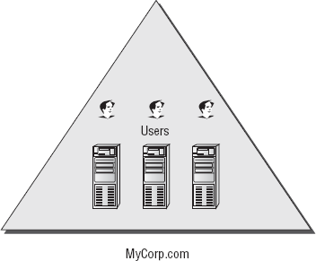
Single Domain Model
The single domain model includes one forest (the root forest domain), which contains:
User Accounts
Group Accounts
Easier to administer/manage
Costs less to maintain
Creates more replication traffic
In a single domain forest, all directory data is replicated to all geographic locations that host domain controllers.

Slide 5
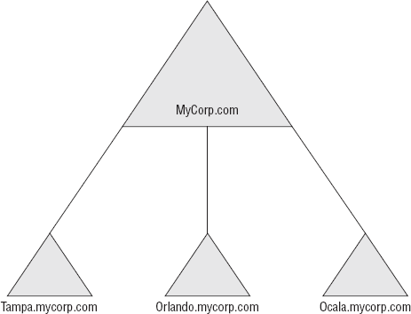
Regional Domain Model
Uses multiple domains (subdomains).
All object data within a domain is replicated to all domain controllers in that domain.
Regional domains can be geographically categorized.
Allows a more stable environment to be maintained over time.
Reduces replication traffic over the WAN (Wide Area Network).
Consists of:
A forest root domain
One or more regional domains
In this example, there are three domains nested under the root domain (MyCorp.com), and they are based on the locations of the company.

Slide 6
The Number of Domains
Each forest starts with one domain.
The amount of users that a domain forest can contain depends on the available bandwidth which can be used for replication.

Slide 7
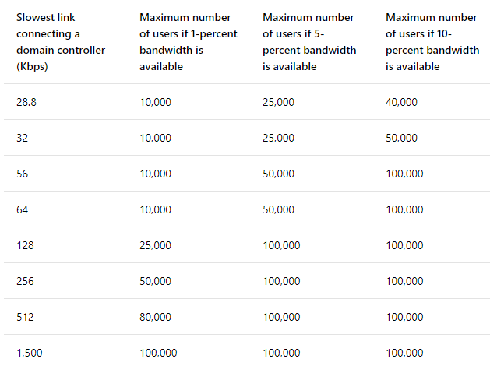
Domain Bandwidth Table
The table above shows estimated bandwidth requirements for different amounts of users on a domain controller. This is based on the bandwidth that would be taken up by replication.

Slide 8
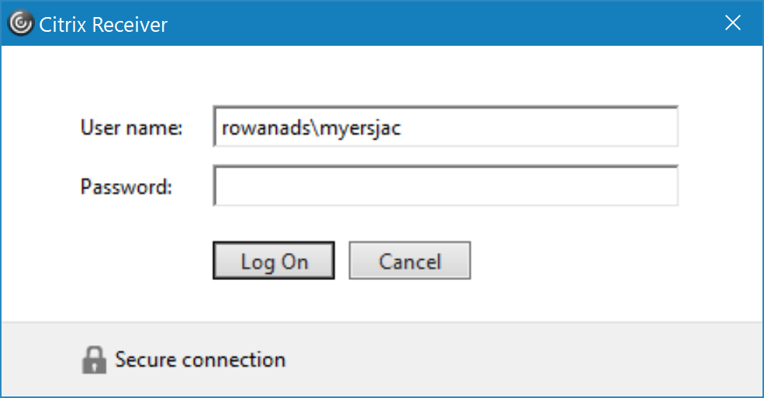
Domain Names
Domains in forests need to have unique names.
There are two types of domain names.
Active Directory Domains
DNS Names
An example would be the following:
AD Domain: rowanads
DNS Name: intranet.example.org

Slide 9
References
EMC Education Services. 2012. Information storage and management: storing, managing, and protecting digital information 2nd ed., Hoboken, NJ: Wiley.
Francis, Dishan. Mastering Active Directory: Automate Tasks by Leveraging PowerShell for Active Directory Domain Services 2016. Packt Pub., 2017.
Billmath. “Reviewing the Domain Models.” Microsoft Docs, Microsoft, 31 May 2017, https://docs.microsoft.com/en-us/windows-server/identity/ad-ds/plan/reviewing-the-domain-models.
“Active Directory: Best Practices for Internal Domain and Network Names.” TechNet Articles - United States (English) - TechNet Wiki, Microsoft, https://social.technet.microsoft.com/wiki/contents/articles/34981.active-directory-best-practices-for-internal-domain-and-network-names.aspx.

