Slide 1
Concepts of
Computing
Technologies
Forests
Notes:
Advanced Learning Assistant Seminar, Spring 2018, Patrick Richeal, richealp7@students.rowan.edu

Slide 2
Objectives
By the end of this lesson, you should be able to:
Plan the structure of an Active Directory infrastructure
Know the two types of forest models
Know about two aspects of forest structures

Slide 3
Designing the Forest Structure
Before designing the Active Directory infrastructure, you will need to plan out what your business requires from the service.
Forest: A complete instance of Active Directory.
Every Active Directory infrastructure has at least one forest.
Types of Forest Models
  Single Forest
  Multiple Forest
forest
collection of domain containers that trust each other
Key Term

Slide 4
Forest Models
Single Forest Model
This is the default forest model
Most business models fit into this category
Less complex than the multiple forest model, which means as a result it costs less
Multiple Forest Model
Compared to the single forest model, this model is:
  More complex
  More costly
    Single there are multiple forests, more hardware/software is needed
Use cases:
  Businesses with independent groups
  Companies which want to share resources

Slide 5
Creating a Forest Design
The next step is to create a forest design.
Need to figure out what requirements groups in your organization need.
Some of these may include:
  Organizational Structure Requirements
  Operational Requirements
  Legal Requirements

Slide 6
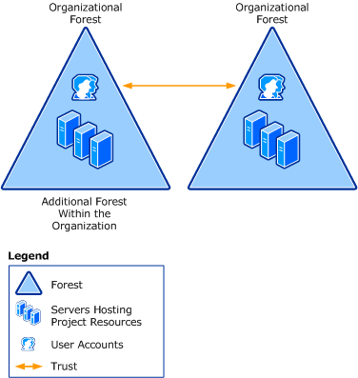
Organizational Forest Model
In this forest model, the following are contained in the forest:
  User Accounts
  Resources
Provides:
  Service Autonomy
  Service Isolation
  Data Isolation
Resources can be shared between forests by using trust relationships.
At least one organizational forest is present in every Active Directory design.

Slide 7
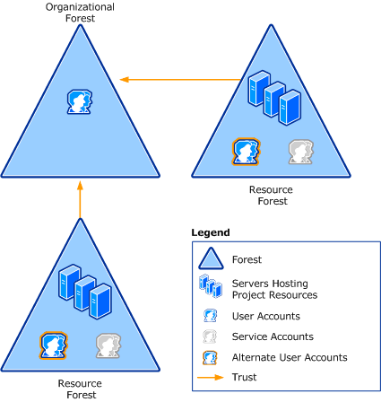
Resource Forest Model
In this forest model, resources are managed separately in a different forest.
  This is known as a Resource Forest.
Provides:
  Service Isolation
A Resource Forest does not contain user accounts.
Other users from different forests can access data using forest trusts.
Notes:
This forest model can be used in parts of businesses which need to maintain availability to the system.

Slide 8
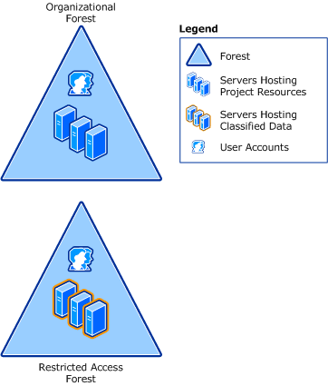
Restricted Access Forest Model
In this forest model, users or data which need to be isolated are put in a separate forest.
Provides:
  Data Isolation
Requirements:
  A different user account will be needed to access the restricted forest.
  A separate physical computer will be needed by the user to access it.
  Depending on the importance of the data on the restricted forest, it can be put on a completely different network.

Slide 9
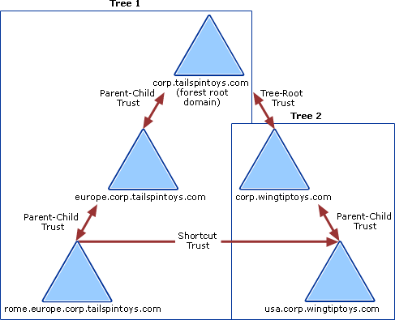
Types of Trust Relationships
Trust Relationships allow you to provide
security across multiple domains.
  Parent/Child Trust: Parent-child Trust is an implicitly established, two-way, transitive trust when you add a new child domain to a tree.
  Tree Root Trust: Tree-root Trust is an implicitly established, two-way, transitive trust when you add a new tree root domain to a forest.
  Shortcut Trust: You may want to create a shortcut trust between domains of the same Active Directory forest if you need to improve the user login experience (no need to use root nodes). The shortcut trust is always transitive and direction can be one-way or two-way.

Slide 10
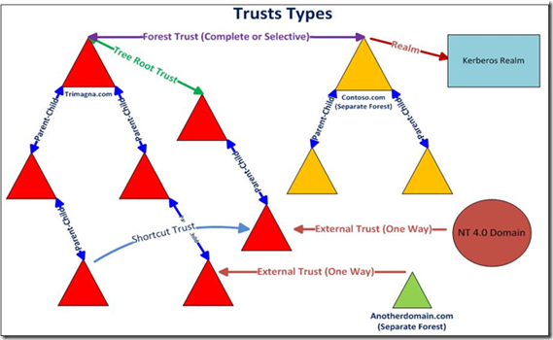
Types of Trust Relationships
  Forest Trust: You will be required to create a forest trust if you need to allow resources to be shared between Active Directory forests. Forest trusts are always transitive and the direction can be one-way or two-way.
  External Trust: You will create an external trust only if the resources are located in a different Active Directory forest and there is no Forest Trust. An external trust is always nontransitive and it can be a one-way or two-way trust.
  Realm Trust: Realm trusts are always created between the Active Directory forest and a non-Windows Kerberos directory such as eDirectory, Unix Directory, etc. The trust can be transitive and nontransitive and the trust direction can be one-way or two-way.
Trust Relationships allow you to provide
security across multiple domains.

Slide 11
References
EMC Education Services. 2012. Information storage and management: storing, managing, and protecting digital information 2nd ed., Hoboken, NJ: Wiley.
Francis, Dishan. Mastering Active Directory: Automate Tasks by Leveraging PowerShell for Active Directory Domain Services 2016. Packt Pub., 2017.
Billmath. “Forest Design Models.” Microsoft Docs, Microsoft, 31 May 2017, https://docs.microsoft.com/en-us/windows-server/identity/ad-ds/plan/forest-design-models.
“Active Directory Trust Relationships.” Active Directory Trust Relationships, TechieBird, http://www.techiebird.com/wintrust.html.

