Slide 1
Concepts of Computing Technologies Active Directory Objects
Notes:
201820-CS99310 - ADV LEARN ASST SEMINAR COM SCI (Section 1) - Spring 2018
Brennan Ringel
Email: ringelb8@students.rowan.edu
Email2:brennanringel@gmail.com

Slide 2
Objectives
By the end of this lesson, you should be able to:
Understand what an Active Directory Object is.
Understand the difference between a container and a leaf object.
Understand what Object Attributes are.
Know a few different ways to uniquely identify objects including
Their GUID/SID
Their Distinguished Name

Slide 3
Active Directory Objects
In the real world, objects have different attributes.
Generally, some of these attributes are unique to a particular object.
Many real physical entities are present within organizations.
To properly model and manage these entities in Active Directory, these must be presented to Active Directory. They are then understood by Active Directory as Objects.
Types of Objects
Container Objects
These store other objects in the Active Directory.
Sometimes, these other objects are other Container Objects.
The Domain is an example of a container Object.
Leaf Objects
These can not store other objects.
A service account is an example of a leaf object.
Notes:
(bullet 1) note some personal examples (I am 6 feet tall, my email is teacher@rowan.edu, my SSN is 555-55-5555).
(bullet 2) Mention things like, no one shares my email, or my SSN. Those are unique to “me”.

Slide 4
Object Attributes
Objects have some minimum number of attributes that must be filled in in order to create the object. User accounts, for example, must have at least a “Name”.
Which fields need to be filled in are determined by an Object’s class. Users, groups, computers, printers, and domain controllers are examples of object classes
There are other attributes that may be defined later on, or left blank after creation.
By modifying the Active Directory Schema, it is possible to add additional attributes to object classes and thus store new information.

Slide 5
Uniquely Identifying Objects
User and group objects receive a globally unique identifier (GUID) and security identifier (SID).
The GUID value will be saved in the objectGUID attribute in each object and the SID value will be saved in the objectSid attribute in each object.
ObjectGUID is a 128-bit value and is applied to each and every object in Active Directory. While there is no guarantee that two objects won’t get the same ObjectGUID, this is very unlikely.
The SID value for an object is unique within its domain.
If a user object is migrated to another domain, a new SID value will be generated. The new domain will not accept the SID generated by other domain.
An SIDHistory is kept in order to make sure it does not lose access to its resources before the access control list is modified to reflect the new SID.
Notes:
(3rd bullet) Maybe talk about how that’s like 340 undecillion possibilities

Slide 6
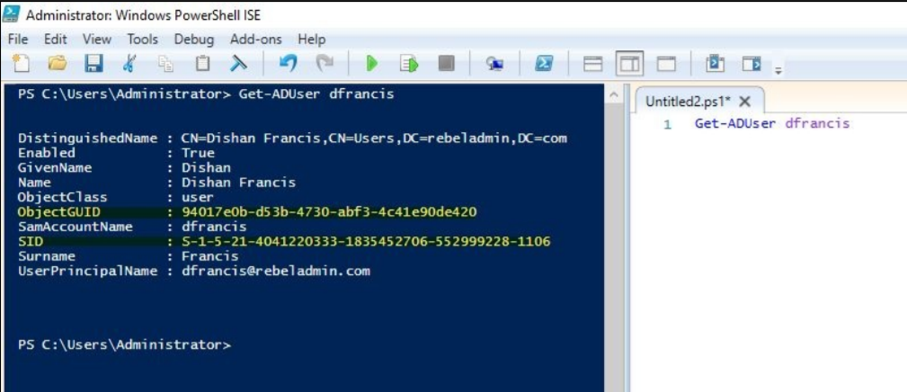
Viewing GUID and SID
The cmdlet: Get-ADUser username will allow you to view the GUID and SID for a given user.
(Francis)

Slide 7
Distinguished Names
Another way to identify an object uniquely.
Similar to a postal address.
There may be many John Smith’s, but there’s likely not more than one at a given address.
Similarly, giving a full path to an object within a directory will help you to uniquely identify that object.
The relative distinguished name (RDN) is a unique value within its parent container.
Active Directory allows you to have the same RDN for multiple objects within the directory, but all of them need to be in separate containers.
Three types of Active Directory naming attributes have been used to generate distinguished names:
organizationName (O) or organizationalUnitName (OU): Organization represents the root-level domain. The organization unit refers to the OU in which the object is located
domainComponent (DC): This is the naming attribute for the domain and the DNS. If the DNS name for the domain is rebeladmin.com, the domain component for it will be DC=rebeladmin,DC=com.
commonName (CN): This refers to the objects and containers within the directory.
Notes:
In the previous screenshot, when the query for the domain user is returned, the distinguished name for the user is as follows: CN=Dishan Francis,CN=Users,DC=rebeladmin,DC=com
There, DC=rebeladmin,DC=com represents the domain name, CN=Users represents the user container, and at the end, CN=Dishan Francis represents the actual object name For the last example, the RDN for the object is CN=Dishan Francis.

Slide 8
Creating Active Directory Objects
When creating objects, values need to be provided according to the object’s type.
Objects have attributes that are mandatory, and those that are not. Mandatory attributes must be provided, and non-mandatory ones can be left out.
Organizations may decide that some custom attributes need to be added to an object’s type.

Slide 9
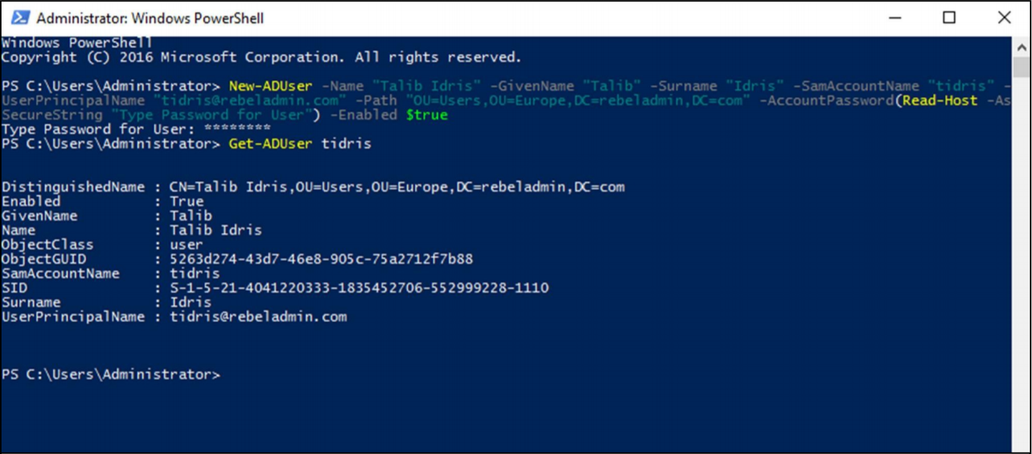
Creating User Objects (Example)
(Francis)
Notes:
Note how when we add new users, the field value is followed by the field name. For example, we have -Name followed by “Talib Idris” which denotes we are making an account for Talib Idris. Remember that this field (-Name) must be included when creating new User objects.

Slide 10
Creating User Objects (Example (Parameters Explained))
-Name: This parameter defines the full name.
-GivenName: This parameter defines the first name
-SurName: This parameter defines the surname.
-SamAccountName: This parameter defines the username.
-UserPrincipalName: This parameter defines the UPN for the user account.
-Path: This defines the OU path. The default location for rebeladmin.com is CN=Users,DC=rebeladmin,DC=com. If you do not define the -Path value, it will create the object under the default container.
-AccountPassword: This will allow the user to input a password for the user, and the system will convert it to the relevant data type
-Enabled: This defines whether the user account status is enabled or disabled
(Francis)
Notes:
Here are the parameters we used in the previous example, as well as a definition of what each parameter takes.

Slide 11
Creating Computer Objects
When a desktop computer or member server is joined to a domain, it will create a computer object in Active Directory.
In order to create a computer object, we can use the New-ADComputer cmdlet. The full syntax of the command can be viewed by entering Get-Command New-ADComputer -Syntax at the PowerShell command line.
Like users, you must at least define a name when creating a computer object.

Slide 12
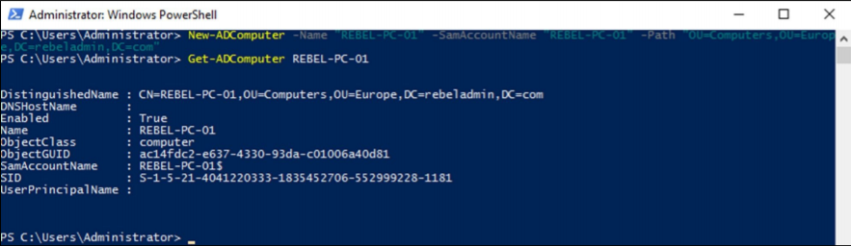
Creating Computer Objects in Powershell
Here is an example of the New-ADComputer cmdlet being used:
Notes:
While we can import many computer objects using the Import-Csv cmdlet that we used when mass importing users, it is rarely needed.

Slide 13
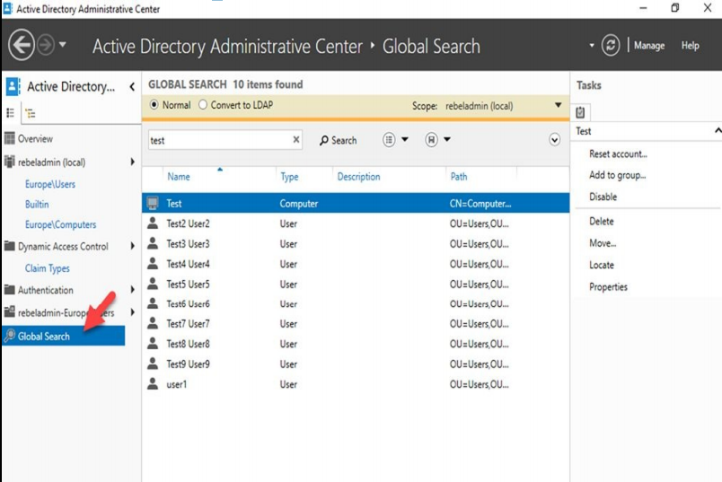
Finding Objects in Active Directory
Active Directory Administrative Center (ADAC) also has a feature called Global Search, which can be used to search for objects in the entire directory. This allows a typical text-based search or advanced LDAP-based queries:
(Francis)

Slide 14
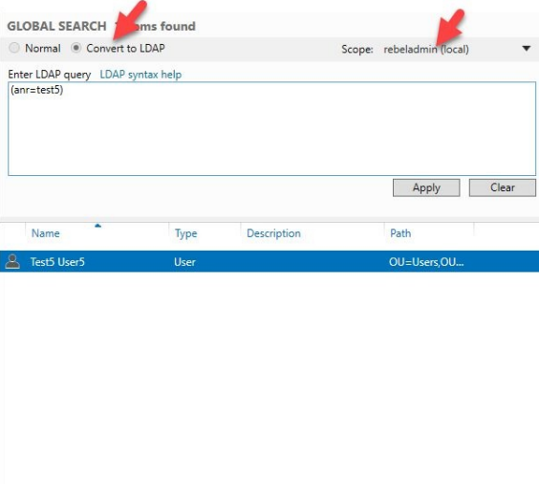
Using LDAP Based Queries
In a Normal search, you can use any text pattern. This can be a complete or partial value.
In an LDAP search, we need to use exact syntax.
We can generate an LDAP query from a Normal search sing the convert to LDAP option.
(Francis)

Slide 15
References
Francis, Dishan. Mastering Active Directory: Automate Tasks by Leveraging PowerShell for Active Directory Domain Services 2016. Packt Pub., 2017.

