Slide 1
Concepts of Computing Technologies
Active Directory Introduction
Notes:
201820-CS99310 - ADV LEARN ASST SEMINAR COM SCI (Section 1) - Spring 2018
Brennan Ringel
Email: ringelb8@students.rowan.edu
Email2:brennanringel@gmail.com

Slide 2
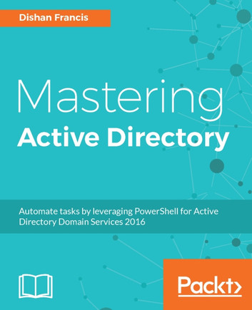
Source Material
Materials for this module primarily come from Mastering Active Directory by Dishan Francis

Slide 3
Objectives
By the end of this lesson, you should be able to:
Understand what active directory is.
Understand the benefits of using active directory.

Slide 4
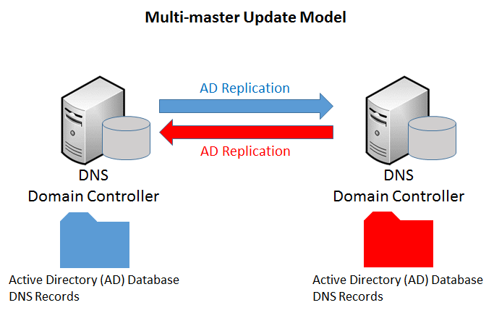
What is Active Directory?
Active Directory (AD) is a tool used to manage identities
Some types of identities that can be managed with AD are:
User accounts
Applications
(Other) Resources
AD stores the identity information of users, applications, and resources in a multi-master database.
Key Term
Multi-master database
a database that uses multi-master replication. Any object-level changes made in one domain controller’s database will be replicated to all other domain controllers (directory service-related).

Slide 5
Benefits of using Active Directory
Centralized Data Repository
Replication of Data
High Availability
Security
Auditing capabilities
Single sign-on
Schema modification
Querying and indexing
Identity information of users, applications, and resources is stored in a multi-master database.
This database is a file called ntds.dit
The data in this database can be modified using any alternative domain controller

Slide 6
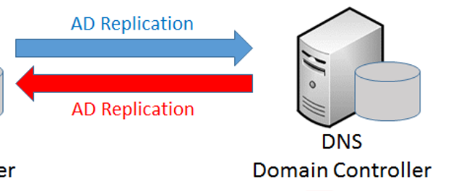
Benefits of using Active Directory
Centralized Data Repository
Replication of Data
High Availability
Security
Auditing capabilities
Single sign-on
Schema modification
Querying and indexing
Often, it is required for an organization to have multiple domain controllers.
All Domain controllers need to know when changes are made to other DCs.
If a domain controller advertises the changes made on that particular domain controller to neighboring domain controllers, it is called outbound replication.
If a domain controller accepts changes advertised by neighboring domain controllers, it called inbound replication
Inbound replication
Outbound replication
Notes:
(2nd bullet) If someone changes their password and has to go to a different branch soon after, and the change is not replicated, then there would be an issue when the person got there.

Slide 7
Benefits of using Active Directory
Centralized Data Repository
Replication of Data
High Availability
Security
Auditing capabilities
Single sign-on
Schema modification
Querying and indexing
Active Directory domain controllers have built in fault tolerance capabilities.
A multi-master database and replication of domain controllers allow users to continue with authentication and authorization from any available domain controller at any time.

Slide 8
Benefits of using Active Directory
Centralized Data Repository
Replication of Data
High Availability
Security
Auditing capabilities
Single sign-on
Schema modification
Querying and indexing
In modern society, identity security is very important, since it can be used to access much of our important data.
Active Directory allows for the use of different types of authentication types, group policies, and workflows in order to protect the users, applications, and resources in the network.
Different Security rules can be enforced based on departments and groups in the network, which can help protect data.
It also forces individuals to follow organizational data- and network-security standards.
There are also options for authentication without a password.

Slide 9
Benefits of using Active Directory
Centralized Data Repository
Replication of Data
High Availability
Security
Auditing capabilities
Single sign-on
Schema modification
Querying and indexing
Periodic audits help you to understand new security threats.
Active Directory allows you to capture and audit events occurring in your identity infrastructure.
This can be done from a centralized location, which will help you troubleshoot authentication and authorization issues users may have.

Slide 10
Benefits of using Active Directory
Centralized Data Repository
Replication of Data
High Availability
Security
Auditing capabilities
Single sign-on
Schema modification
Querying and indexing
In an organization, there are different applications in use.
Most application vendors now support integration with Active Directory for authentication.
This means users can sign on once in order to use these applications that are integrated with Active Directory.
Notes:
(3rd bullet) - Might be good to mention how things seem to be done with a single sign on nowadays for google and apps that support authentication through google to drive the point home.

Slide 11
Benefits of using Active Directory
Centralized Data Repository
Replication of Data
High Availability
Security
Auditing capabilities
Single sign-on
Schema modification
Querying and indexing
Any kind of database has its own structure, called schema.
This is also true of an Active Directory Database.
Active Directory schemas can be extended to allow you, or application developers to store more information on your objects in the database.

Slide 12
Benefits of using Active Directory
Centralized Data Repository
Replication of Data
High Availability
Security
Auditing capabilities
Single sign-on
Schema modification
Querying and indexing
The Active Directory database allows for users and applications to query objects, and information about those objects.
More on this will be discussed in the Managing Active Directory Objects section.

Slide 13
References
Francis, Dishan. Mastering Active Directory: Automate Tasks by Leveraging PowerShell for Active Directory Domain Services 2016. Packt Pub., 2017.
Haber M.J., Hibbert B. (2018) Password Less Authentication. In: Privileged Attack Vectors. Apress, Berkeley, CA
Wanner, Ronja. “Terms and Definitions for Database Replication.” Http://Postgres-R.org, 0AD, postgres-r.org/documentation/terms.

