Slide 1
Concepts of Computing Technologies ITIL Service Strategy
Introduction
Strategy Management for IT Services
Notes:
Replace this with your course title and your name/contact details.

Slide 2
Objectives
By the end of this lesson, you should be able to
Identify and describe key characteristics of the ITIL service strategy lifecycle phase
Identify and describe the formal processes, subprocesses, and Key Performance Indicators (KPIs) that compose the ITIL service strategy lifecycle phase

Slide 3
ITIL Begins with Service Strategy

Slide 4
The Importance of a Service Strategy
Customers expect IT services to “flow” effortlessly across the screens of their devices.
Providing IT service that meets customers’ expectations cannot be achieved by throwing together a solution that you think might work and then correcting as you go.
You must consider all relevant factors up front:
The capacity of your servers
The current demand for the service
The number of people who will be participating in the design and delivery of the service.

Slide 5
Strategies are Proactive
Service strategy is the launch pad for nearly all ITIL-based renovations, transitions, or new IT projects.
The service strategy volume is aimed at providing IT departments with a way to analyze available resources, within the context of the current project, and to do so, moreover, from the standpoint of a business owner.
The goal of the service strategy volume is to allow IT service management to be handled as a strategic asset, not just a technological one.
Service strategy also provides guidance for the ways IT departments can position themselves for healthy long-term growth.

Slide 6
Strategy Management for IT Services

Slide 7
Assess Patterns of Business Activity
In ITIL, assessing patterns of business activity (PBAs) can be incredibly useful when creating service strategy.
PBAs will not just help you define the services your customers want, they will also help you better understand the types, frequency, and magnitude of unique demands that will be placed upon IT while providing the service.
There are certain times of the day / month / year the business behaves in a way which impacts IT
Patterns of Business Activity help the IT service provider understand and plan the capacity to handle different levels of business activity.
Demand Patterns can be used to influence how customers use services.

Slide 8
etc,
Brewster, et.al.

Slide 9
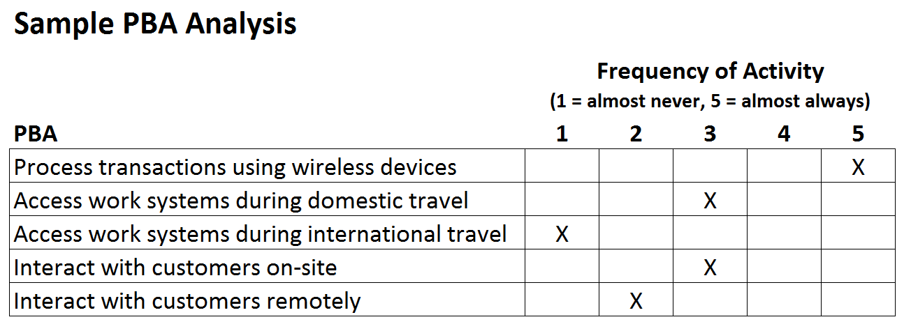
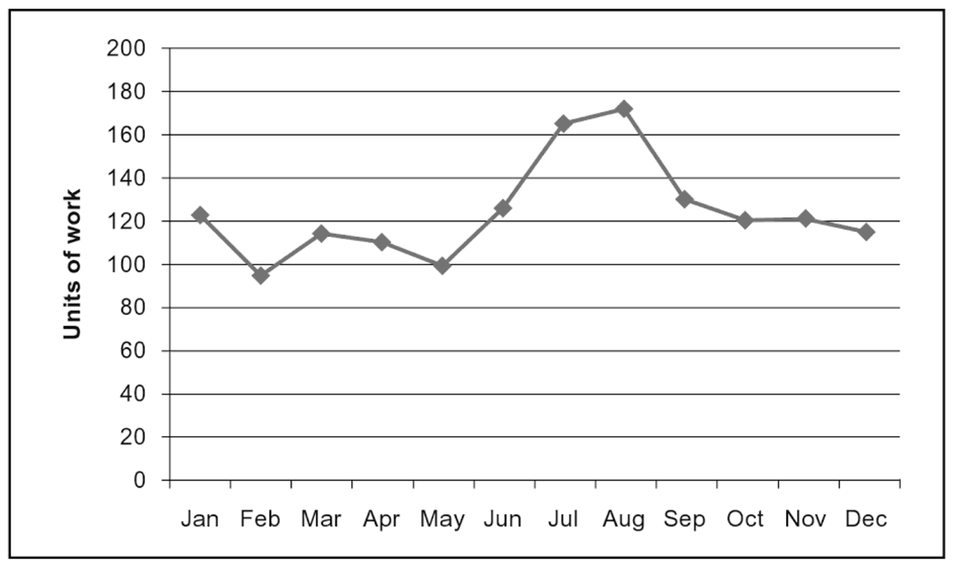
Understanding Patterns of Business Activity
There is clearly a relationship between business activities and the consumption of IT resources
The challenge is to understand that relationship well enough so that when the business shares its plans and forecasts, IT can predict the impact on their resources.
Can peak demands be reduced? (Otherwise, IT will need to spend extra money on capacity to handle the original peaks.)
Sample Workload Profile
Brewster, et.al.

Slide 10
Practicing the Concepts
Research Activity: Service strategy example – Massively multiplayer online role-playing games (MMORPGs)
World of Warcraft: Maintenance Tuesdays
Star Wars, the Old Republic: Server Merges
World of Warcraft: Cross-Realm Zones
Scenario Development: Try to think of scenario where patterns of business activity will influence an IT service.

Slide 11
User Profiles
User profiles can be based on the roles and responsibilities of an organization.
Often different types of users will have different patterns of business activity.

Slide 12
Components of Service Strategy
The main subprocesses included under the information technology service management process include:
Strategic Service Assessment:
Examines the current status and capability of the service provider within its business context
An inventory of what the customer needs, what IT currently offers, and available offerings from other service providers. (like a competitive analysis)
Service Strategy Definition
A review of the strategic service assessment and determination of the goals to be pursued by IT. This subprocess
Identify which customers or customer segments can be served and what solutions should be developed to meet those service demands.
Service Strategy Execution
Defines and plans strategic initiatives and
Ensures satisfactory follow-through on execution.

Slide 13
References
Ernest Brewster. 2012. IT service management: a guide for ITIL Foundation Exam candidates, Swindon: BCS. about figuring out controls. In ITIL, assessing patterns of business activity (PBAs) can be incredibly
ClydeBank. ITIL For Beginners: The Complete Beginner's Guide To ITIL ClydeBank Media LLC.

